Slide 1
Understanding Interferon Gamma Release Assays, and an Update on Tuberculosis Treatment
Sonal S. Munsiff, MD
Assistant Professor
Division of Infectious Diseases, Department of Medicine University of Rochester School of Medicine and Dentistry
April 25, 2014

Slide 2
Today’s Talk
Basics of IGRAs
Using IGRA for diagnosing Latent TB infection
Serial testing with IGRAs
Limitations and areas for ongoing research
Active TB treatment essentials
Treatment of HIV co-infected persons

Slide 3
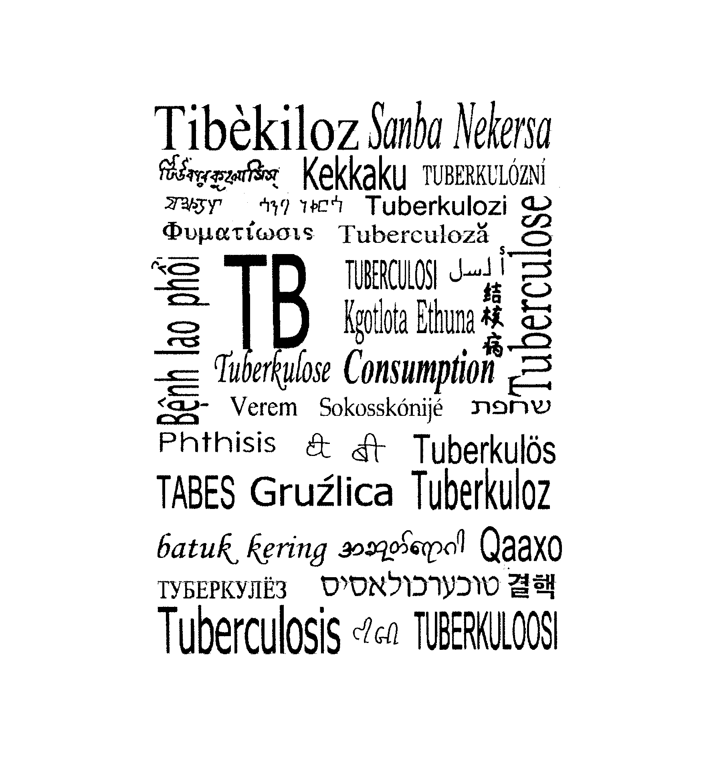

Slide 4
A Model of Tuberculosis Epidemiology
Risk
Factors
Risk Factors
Risk
Factors
Risk
Factors
Infectious
tuberculosis
Subclinical
infection
Exposure
Death
Non-infectious
tuberculosis
IUATLD. Epidemiologic Basis of Tuberculosis Control. 1999:9

Slide 5
Interventions to control Tuberculosis
Chemotherapy of active cases
Preventive therapy
Prophylactic therapy
BCG Vaccination

Slide 6
Transmission
Chemotherapy
Doctor's delay
Prophylactic
Preventive
Patient's delay
treatment
therapy
Infectious
tuberculosis
Exposure
Subclinical
Death
infection
Non-infectious
tuberculosis
BCG
BCG
vaccination

Slide 7
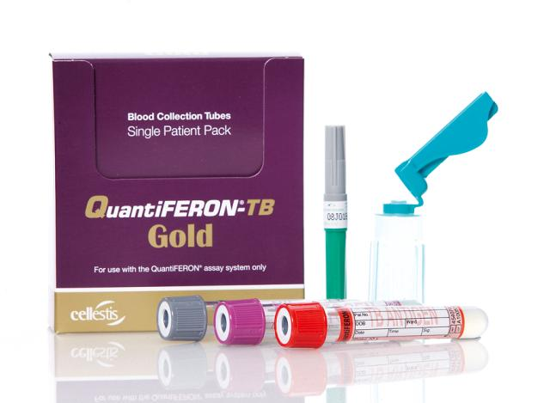
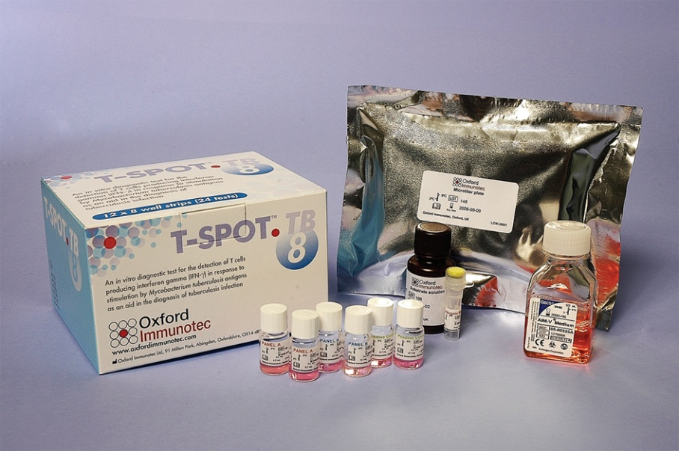
Methods for detecting M. tb Infection in U.S.
Mantoux tuberculin skin test (TST)
IGRAs:
QuantiFERON-TB Gold In-Tube (QFT-GIT)®, and
T-Spot.TB®
Both IGRAs are FDA approved

Slide 8
Limitations of the TB Skin Test
False positive reactions due to many reasons, including:
BCG vaccination
Immune reactivity to non-tuberculosis mycobacteria (NTM)
- In US-born individuals, up to 50% of TST responses can be due to NTM infections (1)
False negative, specially with advanced TB, immunosuppressed persons
Difficulty in proper intradermal injection of PPD
Need to interpret the test 2-3 days after PPD injection
Often people do not return for reading
Subjective:
Two different readers, can get two answers
Different cut-offs for different situations (≥ 5mm, ≥ 10mm, ≥ 15mm)
Boosting: as PPD antigen is injected into the person, this can lead to the boosting of a subsequent test and a false-positive result, especially in those BCG vaccinated
1. von Reyn CF., et al. (2001) Int J Tuberc Lung Dis 5 (12), 1122-1128

Slide 9
Interferon Gamma Release Assay (IGRA) Guidelines in US
Insert 2010 CDC Guidelines
Notes:
Introduce topic by showing that IGRA’s are a new alternative for TB testing supported by recommendations by the CDC.

Slide 10
Interferon Gamma Release Assays (IGRAs)
Two IGRAs commercially available:
QuantiFERON®-TB Gold (QFT®) and T-Spot®.TB (Elispot-based IGRA)
Both IGRAs measure the secretion of the cytokine interferon-gamma (IFN-γ) by lymphocytes stimulated in vitro with TB-specific antigens
Cannot differentiate between TB and LTBI
Detect M. tb infection with greater specificity than TST
May be more sensitive in certain populations
Data are limited on ability to predict subsequent TB

Slide 11
General Recommendations for Using IGRAs
May be used in place of, but not in addition to, TST
Preferred when testing persons
Who might not return for TST reading
Who have received BCG vaccination
May be used for surveillance/screening, or to find those who will benefit from treatment
May be used in place of TST to test contacts; confirm negative via retest 8–10 weeks post exposure
Use same test for repeat testing to reduce misclassification errors
Generally should not be used to test children <5 years of age, unless used in conjunction with TST

Slide 12
General Recommendations for Using IGRAs (cont.)
May be used for periodic screening, e.g., for health care workers
IGRAs do not boost subsequent test results; administered with one patient visit
Results from both IGRA and TST may be useful when initial test is
Negative, and patient has high risk of TB infection or disease
Positive, and additional evidence is required/desired
Unclear or indeterminate

Slide 13
Interpretation of TB Test Results in BCG-Vaccinated Persons
TST or IGRA not contraindicated for BCG-vaccinated persons
Results used to support or exclude diagnosis of infection
In BCG-vaccinated, interpret TST with same criteria used for non BCG vaccinated
Booster phenomenon may occur in BCG-vaccinated persons

Slide 14
Immunologic Basis of IGRAs
In normal circumstances, there is little IFN- γ within the blood.
In the presence of the TB specific antigens, T cells of infected persons are stimulated to produce IFN-γ
In the QFT test
whole blood is exposed to TB specific antigens
T cells of infected persons are activated and secrete IFN-γ
Measure IFN-γ

Slide 15
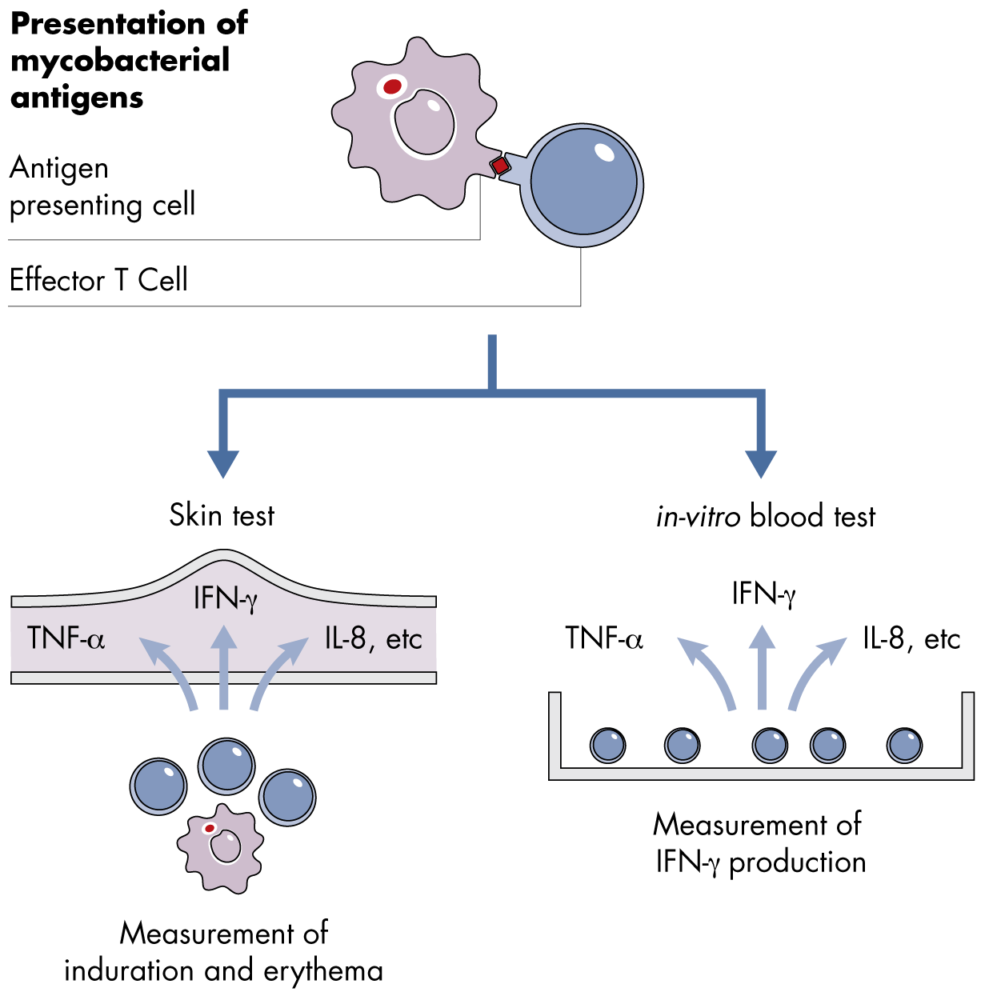
Immunological Basis of QFT
Cytokines in TB testing

Slide 16
Quantiferon Technology
Three Tubes Provide Reliable Meaningful Results

Slide 17
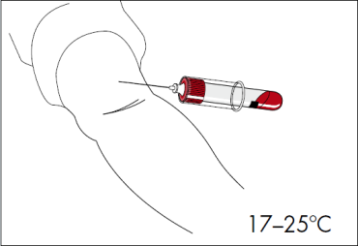
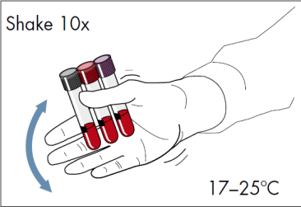
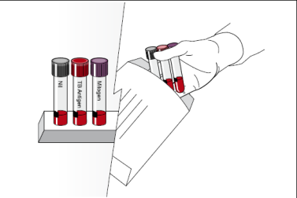
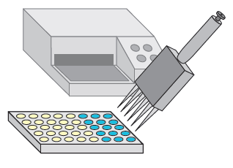
QFT Step-By-Step Procedure
Quick guide
Step 1.
Blood Collection
Step 2. Mixing of Tubes
Step 3. Incubation
Step 4. ELISA*
Step 5. Calculation of Results*
The test is performed by collecting whole blood (1 mL) into each of three blood collection tubes. Tubes are incubated at 37ºC for 16 to 24 hours. The IFN concentration in the plasma is determined using a sensitive ELISA.
* Both of these steps performed in laboratory and can be automated

Slide 18
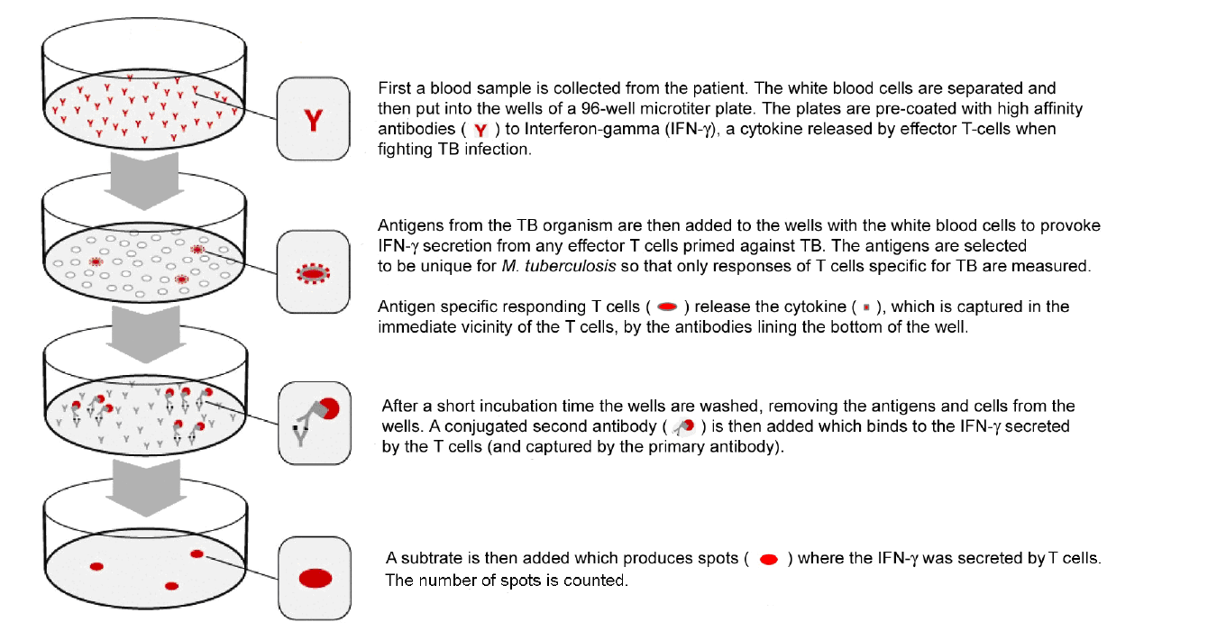
T SPOT .TB testing steps
Elispot-Based IGRA Quick Guide
T Spot Package Insert PI-TB-US-V3 (2012)

Slide 19
Antigens in QFT
QFT is not affected by BCG vaccination (1)
Tuberculosis Complex | QFT TB-Specific Antigens |  |  | TST Antigens
 | ESAT-6 | CFP-10 | TB 7.7 | PPD
M. tuberculosis | + | + | + | +
M. africanum | + | + | + | +
M. bovis | + | + | + | +
BCG Sub-Substrain | QFT TB-Specific Antigens |  |  | TST Antigens
 | ESAT-6 | CFP-10 | TB 7.7 | PPD
Gothenberg | - | - | - | +
Moreau | - | - | - | +
Tice | - | - | - | +
Tokyo | - | - | - | +
Danish | - | - | - | +
Glaxo | - | - | - | +
Montréal | - | - | - | +
Pasteur | - | - | - | +
Environmental strains | QFT TB-Specific Antigens |  |  | TST Antigens
 | ESAT-6 | CFP-10 | TB 7.7 | PPD
M. abcessus | - | - | - | +
M. avium | - | - | - | +
M. branderi | - | - | - | +
M. celatum | - | - | - | +
M. chelonae | - | - | - | +
M. fortuitum | - | - | - | +
M. gordonii | - | - | - | +
M. intracellulare | - | - | - | +
M. kansasii | + | + | - | +
M. malmoense | - | - | - | +
M. marinum | + | + | - | +
M. oenavense | - | - | - | +
M. scrofulaceum | - | - | - | +
M. smegmatis | - | - | - | +
M. szulgai | + | + | - | +
M. terra | - | - | - | +
M. vaccae | - | - | - | +
M. xenopi | - | - | - | +
1. QuantiFERON-TB Gold Package Insert, March 2013
Notes:
QuantiFERON-TB Gold (QFT) is a highly specific in vitro blood test for use as an aid to the diagnosis of M. tuberculosis infection. QFT is unaffected by prior BCG vaccination and most environmental strains of mycobacteria.(1) The tables below illustrate the reactivity of antigens from QFT and the tuberculin skin test (TST) to various species of mycobacteria.
Most antigens contained in Tuberculin are shared by harmless environmental pathogenic mycobacteria and also the attenuated Mycobacterium bovis vaccine
strain, Bacille Calmette-Guerin (BCG). Not surprisingly, BCG vaccination or previous infection with non-tuberculous mycobacteria can cause false-positive TST results.
IGRAs are based on the knowledge of key genetic differences between pathogenic and non-pathogenic mycobacteria, which is why they exhibit the highest degree of TB antigen specificity. In contrast to the TST, IGRAs are not affected by BCG vaccination status or prior infection with non tuberculous
mycobacteria other than M. kansasii, M. marinum, and M. szulgaii.
The QuantiFERON-TB Gold assay incorporates three TB pathogen specific proteins, ESAT-6, CFP-10 and TB7.7

Slide 20
Quantiferon Performance
A sensitive test
would accurately identify people with infection, whether latent or active (maximize true positive results)
Sensitivity = 88.7% in blood up to 16 hours old (using culture confirmed active TB as the Gold Standard) (1)
Specificity >99% (in a group with no known risk factors for M. Tuberculsosis infection, none BCG vaccinated)
A specific test
would accurately identify people who are uninfected (maximize true negative results)
1. QuantiFERON-TB Gold Package Insert, March 2013
2. Mazurek GH., et al. (2010) Centers for Disease Control and Prevention. MMWR 5, 1-28.
Notes:
Note – by comparison, the Skin test has:
Sensitivity of 67-72% (Diel meta analysis Chest 2009)
Specificity:
In non-BCG vaccinated = 97% (Diel meta analysis Chest 2009)
In BCG vaccinated = 59% (Pai et al 2008)

Slide 21
QFT in specific populations
Performance: Predictive value for active TB
An analysis of 954 TB contacts comparing QFT and TST(1)
954 close contacts
198 QFT-positive
756 QFT-negative
142 QFT-positive/
TST-positive
5 QFT-positive
TST-negative
51 QFT-positive
(49 TST-positive)
413 TST positive
343 TST negative
Not treated
Not treated
Chemoprophylaxis RIF and/or INH
Not treated
Not treated
17 developed active TB
2 developed active TB
No active TB
No active TB
No active TB
Mean follow-up >3.5 yr
1. Diel R., et al. (2010) Am J Respir Crit Care Med. 183(1), 88-95

Slide 22
Performance: Negative Predictive Value of QFT
Specificity influences predictive value
55% of QFT-negative were TST-positive
More accurate with fewer false positives
No progression to active TB at 3.5 years
QFT demonstrates 100% NPV in this study
756 QFT-negative
413 TST positive
343 TST negative
Not treated
Not treated
No active TB
No active TB
Mean follow-up >3.5 yr

Slide 23
LTBI – TST and QFT
QFT is more predictive than TST
No active TB in all 51 QFT+ contacts who received tx
All 19 untreated contacts who progressed to active TB were QFT-positive
Progression rate:
QFT+ = 12.9% (19/147)
TST+ @>5mm = 3.1% (17/555)
TST+ @>10mm = 4.8% (10/207)
Sensitivity for progression:
QFT = 100% (19/19)
TST @>5mm = 89% (17/19)
TST @ >10mm = 53% (10/19)
198 QFT-positive
142 QFT-positive/
TST-positive
5 QFT-positive
TST-negative
51 QFT-positive
49 TST-positive
Not treated
Not treated
Chemoprophylaxis RIF and/or INH
17 developed active TB
2 developed active TB
No active TB

Slide 24
Overview Of IGRAs in HIV-infected persons
Patients with HIV infection are at 21-34 times increased risk for progression from LTBI to active TB
Studies in HIV-infected populations have shown
IGRAs are less sensitive in HIV-infected patients vs HIV-uninfected
IGRAs cannot rule out active TB
However, several studies have also shown that
IGRAs are more sensitive for LTBI than the TST in HIV-infected patients
IGRAs contain internal positive controls which assist discrimination between true and false negative TB results
IGRAs are not affected by BCG vaccination for LTBI testing in low TB prevalence settings
Single visit of IGRAs overcomes the TST issue of poor return rates
Notes:
Speaker notes:
Because there is no “gold” standard for LTBI, test sensitivity is usually estimated in patients with active TB.
FDA considers “culture” to be the “gold” standard for active TB diagnosis.
Therefore, sensitivity in HIV-infected patients is based on the studies of active TB among HIV-positive individuals. However, neither QFT nor other IGRAs can distinguish active from latent TB infection.
For further information, refer to the QFT global master training deck “QFT technical performance”.

Slide 25
IGRAs in HIV infected persons
Indeterminate results in HIV-infected patients
IGRAs have a higher rate of indeterminate results in HIV-infected vs HIV-uninfected
Recent meta-analyses show that QFT has a lower rate of indeterminates compared to EBI
Metaanalysis | Rate of indeterminate results, %
 | QFT | EBI
HIV-infected/other immunosuppressed Diel (2010) Chest | 5.6% | 8.3%
HIV-infected Ramos (2012) BMC Infectious Diseases | 2.7% | 7.2%
HIV-infected Hoffmann et al (2010) | 4% | 6.7%
Notes:
Speaker Notes:
Diel et al study included patients with HIV, inflammatory disease, chronic liver disease (end stage), bladder cancer, renal dialysis, rheumatoid arthritis, inflammatory bowel disease, immunosuppressed children, chronic uvetis, IV drug users.

Slide 26
IGRAs in HIV infected persons
Impact of CD4⁺ T cell count on indeterminate results in HIV
CD4⁺ count | Rate of indeterminate results in HIV-infected patients
 | QFT | EBI
CD4⁺ < 200 | 11.6% | 11.4%
CD4⁺ ≥ 200 | 3.1% | 7.9%
1. Santin M. et al. (2012) PLoS One 7(3) e32482.

Slide 27
Serial Testing in Health Care Workers
Study, yr (reference) | Country | Duration between tests | No. of conversions or reversions/total no. of participants (%)
 |  |  | TST conversions | IGRA conversionsª | IGRA reversionsª
Slater et al. (87) | USA | 2 yr | 0.4% (historical) | 361/8,227 (4.4) | 613/1,584 (38.7)
Dorman et al. 2013 (86) | USA | 6 mo | 21/2,293 (0.9) | For QFT, 138/2,263 (6.1); for T-SPOT, 177/2,137 (8.3) | For QFT, 81/106 (76); for T-SPOT, 91/118 (77)
Zwerling et al., 2013 (70) | Canada | 1 yr | 0/241 | 13/245 (5.3) | 8/13 (62)
Joshi et al., 2012 (85) | USA | 1 yr | 0.1% (historical) | 71/2,232 (3.2) | 31/69 (45)
Park et al., 2012 (84) | South Korea | Once-monthly testing for 1 yr | NA | 25/48 (52) had ≥1 conversion over 1 yr | Not reported
Joshi et al., 2012 (73) | USA | 2–30 days | NA | NA | 18/45 (40)
Rafiza and Rampal, 2012 (75) | Malaysia | 1 yr | NA | 69/703 (9.8) | 14/59 (23.7)
Fong et al., 2012 (71) | USA | 1 yr or 1–6 mo for repeat of positive IGRA | NA | 52/1,857 (2.8) | 8/10 (80)^{b}
Notes:
ª All conversions/reversions, using simple negative/positive results.
↵^{b} Note that repeat testing was done among those with positive QFT results close to the cutoff point.
↵c HCW, health care worker; IGRA, gamma interferon release assays; NA, data not available; TST, tuberculin skin test.
↵^{d} Adapted from reference 90 with permission of the publisher.

Slide 28
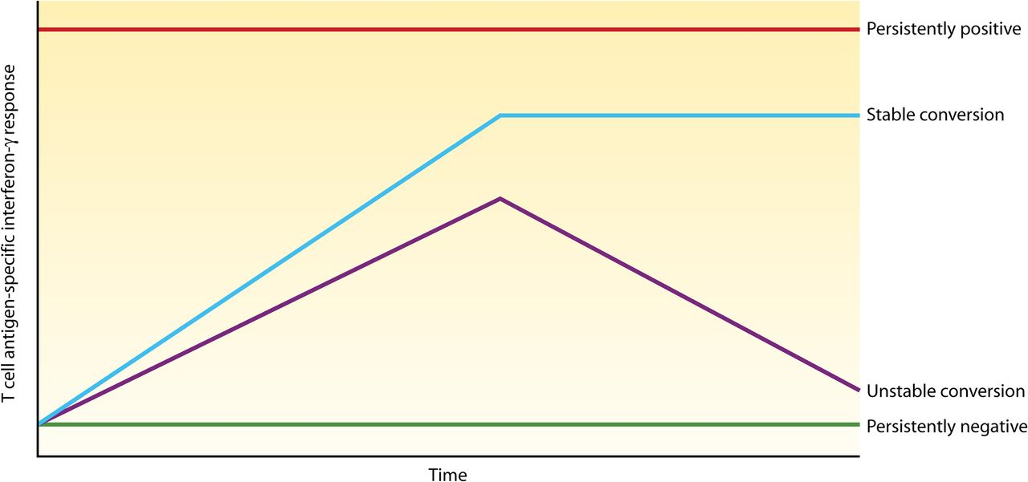
Serial testing with IGRAs reveals underlying phenotypes.
Pai M et al. Clin. Microbiol. Rev. 2014;27:3-20
Notes:
Serial testing with IGRAs reveals underlying phenotypes. The persistently positive pattern is seen in individuals who are repeatedly IGRA positive for a long time. Unstable conversion refers to individuals who convert their IGRA result from negative to positive and then revert again to negativity. Stable conversion refers to individuals who convert their IGRA result and stay converted, at least in the short term. Persistently negative refers to individuals who stay repeatedly IGRA negative for a long time. (Reproduced from reference 88 by permission from Macmillan Publishers Ltd.)‏

Slide 29
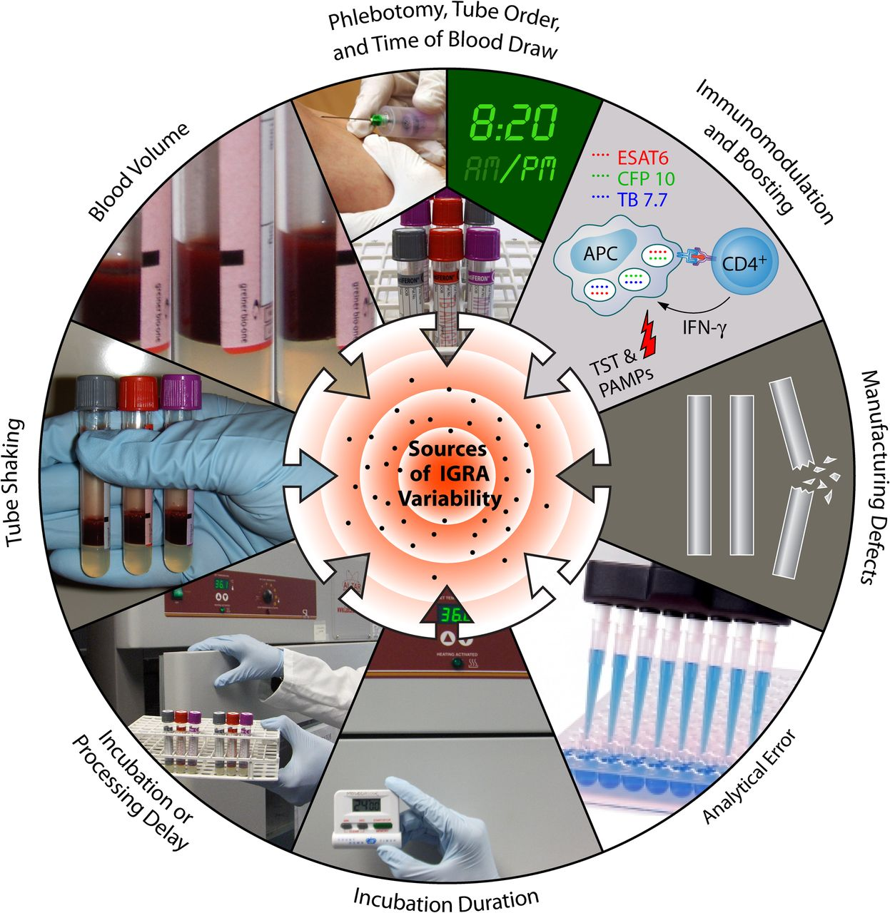
Sources of variability in the QFT-TB Gold In-Tube assay.
Pai M et al. Clin. Microbiol. Rev. 2014;27:3-20
Notes:
Sources of variability in the QuantiFERON-TB Gold In-Tube assay.

Slide 30
IGRA summary
More specific than TST
Less sensitive in HIV infected persons
Serial testing challenged by conversions and reversions at higher rates than TST
Variability in results due to technique
Best way to define conversion not established
Not enough data on prediction of risk for developing active TB

Slide 31
Tuberculosis Treatment Basics

Slide 32
Objectives of Tuberculosis Treatment
Rapid reduction of the number of bacilli
Minimize death and disability
Prevent acquired drug resistance
Sterilize lesions to prevent relapse
Reduce Infectiousness
Rifamycin is essential in achieving TB treatment success

Slide 33
Ensuring Best outcomes in TB Treatment
Provide safest, most effective therapy in shortest time
Prescribe multiple drugs to which the organisms are susceptible, to prevent drug resistance
Never treat with a single drug or add single drug to failing regimen
Ensure adherence and completion of therapy, ideally by Directly Observed Therapy

Slide 34
Current Anti-TB Drugs
11 drugs FDA-approved for treatment of TB
Isoniazid (INH)
Rifampin (RIF)
Pyrazinamide (PZA)
Ethambutol (EMB)
Rifapentine (RPT)
Streptomycin (SM)
Cycloserine
Capreomycin
ρ-Aminosalicylic acid
Ethionamide
Bedaquiline
OFF Label Use
Fluoroquinolones
Rifabutin
Kanamycin/Amikacin

Slide 35
Regimens with Rifampin
Shorter -- 6 to 9 months
Faster sputum conversion
Higher cure rates
Lower relapse rates
Regimens without Rifampin
Increased risk of death in HIV-infected

Slide 36
TB Disease Treatment Regimens
Four regimens recommended for treatment of drug-susceptible TB, with different options for number of doses and for length of continuation phase
Initial phase: standard four drugs (INH, RIF, PZA, EMB) for 2 months (one excludes PZA)
Continuation phase: additional 4 months; 7 months for some patients

Slide 37
Regimen 1 for Treatment of Pulmonary, Drug-Susceptible TB 6-Month Standard Regimen for Most Patients
Initial phase
INH, RIF, PZA, EMB daily (7 or 5 days/week) for 8 weeks
4-month continuation phase options
1) INH, RIF daily (7 or 5 days/week) for 18 weeks
2) INH, RIF intermittently (2 days/week or 1 day/week for INH, rifapentine) for 18 weeks

Slide 38
TB Disease Treatment Regimens (cont.)
When to use 7-month continuation phase:
Disease is cavitary and sputum culture is positive at end of initial phase;
Initial phase excluded PZA; or
Once-weekly INH and RPT used in continuation phase, and culture is positive at end of initial phase.

Slide 39
Regimen 3 for Treatment of Pulmonary, Drug-Susceptible TB 6-Month Intermittent Dosing Options
Initial phase
INH, RIF, PZA, EMB intermittently (3 days/week) for 8 weeks
4-month continuation phase
INH, RIF intermittently (3 days/week) for 18 weeks

Slide 40
Regimen 4 for Treatment of Pulmonary, Drug-Susceptible TB 7-Month Regimen without Pyrazinamide
Initial phase
INH, RIF, EMB daily (7 or 5 days/week) for 8 weeks
7-month continuation phase options
1) INH, RIF daily (7 or 5 days/week) for 31 weeks
2) INH, RIF intermittently (2 days/week) for 31 weeks

Slide 41
Treatment Regimens for Specific Situations
Pregnant Women
Initial regimen should consist of INH, RIF, and EMB
SM is contraindicated; PZA not contraindicated, but detailed data on teratogenicity not available
If PZA not used, duration of therapy is 9 months
If treating MDR TB in pregnancy, consult MDR TB expert
Breast-feeding not contraindicated for women being treated for TB disease
Vitamin B₆ supplementation recommended if taking INH

Slide 42
Treatment Regimens for Specific Situations
Infants and Children
Treat with same regimens recommended for adults, with exception that EMB not used routinely in children
Treat as soon as diagnosis suspected
For disseminated TB or TB meningitis in children, treat for 9–12 months

Slide 43
Treatment Regimens for Specific Situations HIV-Infected Persons
Management of HIV-related TB is complex
Should be provided in consultation with experts in treatment of both HIV and TB
Can be treated with standard regimens except:
Do not use once-weekly continuation-phase INH and RPT
In patients with advanced HIV, use daily or 3x weekly therapy

Slide 44
Common Cytochrome P450 Drug Interactions
Mechanism Examples Clinical effect
on other drugs
Induction of Rifampin>Rifapentine> ↓ serum conc.,
CYP3A Rifabutin, efavirenz, ↓ efficacy
nevirapine
Inhibition of Ritonavir>ketoconazole> ↑ serum conc.,
CYP3A indinavir, lopinavir, nelfinavir, ↑ toxicity
amprenavir, atazanavir,
darunavir, tipranavir,
delavirdine> saquinavir

Slide 45
Treatment Regimens for Specific Situations HIV-Infected Persons (cont.)
Use a rifamycin for the entire course of therapy, along with antiviral therapy (ART)
A major concern: RIF interacts with PIs, some NNRTIs and others
OK to use with Efavirenz which is preferred regimen
Nevirapine is an alternate
Rifabutin has fewer drug interactions and may be used instead of RIF with most ART regimens. Rifabutin dose needs adjusting depending on ART
Integrase inhibitors- raltegravir dose doubles, but little clinical data
CDC. Managing Drug Interactions in the Treatment of HIV-Related Tuberculosis (online). 2013

Slide 46
Conditions Requiring Additional Considerations
Renal insufficiency/end-stage renal disease
Some TB drugs are cleared by the kidneys; thus the dosing must be altered with renal disease
Rather than decrease dosage size, increase dosing interval
Hepatic disease - consider regimens with fewer hepatotoxic agents
Extrapulmonary TB - In most cases, treat with same regimens used for pulmonary TB

Slide 47
Evaluating Response to Treatment
Bacteriological examination
If cultures do not convert to negative after 3 months of therapy, evaluate patient for drug resistance or adherence issues; after 4 months, consider treatment failed
Chest radiograph
Patients with initially negative cultures should have chest radiograph after 2 months of treatment and at completion of therapy
CXR at end of treatment to establish new baseline

Slide 48
The Future of TB treatment?
TBAlliance.org

