Slide 1
MDR and XDR TB
Bruce A. Bush, M.D.
Regional Tuberculosis Consultant
Pennsylvania Department of Health
Senior Vice President for Medical Affairs
Indiana Regional Medical Center

Slide 2
Disclosures
I do not have any financial arrangements or affiliations with a commercial entity.

Slide 3
Objectives
Review the definitions and categorization of drug-resistant tuberculosis.
Understand the emergence of drug resistance, and learn how to prevent it.
Grasp the global tuberculosis situation and the risk it poses.
Learn the principles and specifics of treatment of MDR TB.
Briefly discuss XDR TB.

Slide 4
Definitions
MDR TB: TB isolate that is resistant to both isoniazid and rifampin
XDR TB: MDR + resistance to fluoroquinolone and 1 of the 3 injectable drugs (amikacin, kanamycin, capreomycin)
Notes:
definitions for drug resistance…
MDR TB implies resistance to at least isoniazid and rifampin
XDR TB is defined as MDR TB and resistance to the 2 most important classes of 2nd-line agents used in MDR TB treatment: fluoroquinolones and 1 of the 3 injectable agents
Patients with XDR TB are usually resistant to all four 1st line agents

Slide 5
Definitions
Primary drug resistance:
Infected with TB which is already drug resistant
Secondary (acquired) drug resistance:
Drug resistance develops during treatment
Notes:
Primary drug resistance means the the patient has drug resistance due to transmission of a drug resistant strain from a drug resistant source. In other words, the patient became infected with a strain that was already drug resistant.
Secondary drug resistance means that the resistance was acquired during the course of TB treatment
MDR TB
Resistance to at least isoniazid and rifampin
MDR TB Importance: No short course treatment regimen available and requires use of more toxic drugs
XDR TB Importance: Significantly poorer outcome

Slide 6
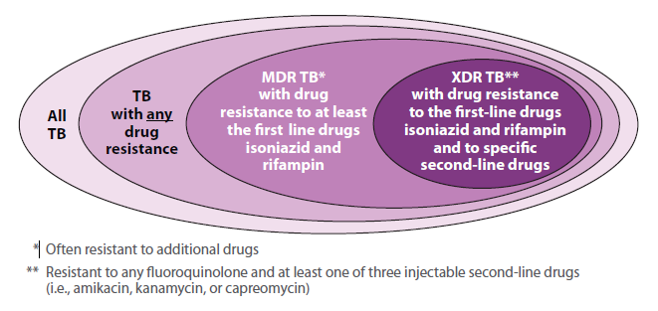
The Universe of TB

Slide 7
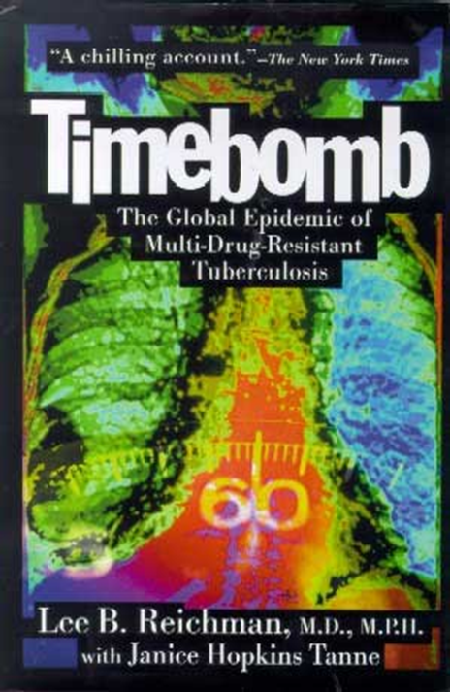
Drug Resistant TB is Man-Made
It is the result of interrupted, erratic, or inadequate TB therapy, and its spread is undermining efforts to control the global TB epidemic.
It is costly, deadly, debilitating, and the biggest threat to our current TB control strategies.

Slide 8
Spontaneous mutations
develop as bacilli
proliferate to >10⁸
Drug | Mutation Rate
Rifampin | 10⁻⁸
Isoniazid | 10⁻⁶
Pyrazinamide | 10⁻⁶
Notes:
M. tuberculosis bacteria become resistant to anti-TB drugs by acquiring mutations that confer resistance. Such mutations develop spontaneously as the bacteria proliferaet in the host.
Rif-R mutants arise at a frequency of 1 in 10exp-8
INH-R and PZA-R mutants arise at a frequency of 10exp-6
So, prior to treatment, the population of bacteria in a TB patient already contains drug-resistant bacteria.

Slide 9
Multidrug therapy:
No bacteria resistant to all 3 drugs
Drug-resistant mutants in large bacterial population
INH
RIF
PZA
Monotherapy: INH-resistant bacteria proliferate
INH
Notes:
If one treats this population with three effective drugs, all bacteria are killed.
However, if one treats with only one drug, say INH, one selects for INH resistant bacteria. --→

Slide 10
Spontaneous mutations
develop as bacilli
proliferate to >10⁸
INH resistant bacteria multiply
to large numbers
INH
RIF
INH
INH mono-resist.
mutants killed,
RIF-resist. mutants proliferate → MDR TB
Notes:
These bacteria then can multiply to large numbers and once again spontaneous mutations can arise. In this case acquisition of a second drug resistance. Treatment with two drugs then leads to selection of the MDR strain and its proliferation can lead to the acquisition of additional resistance. This sort of amplification of drug resistance can occur one drug at a time to ultimately lead to XDR TB. -→

Slide 11
Drug-resistant TB can occur when drugs are misused or mismanaged
Examples include:
When people do not complete the full course of treatment;
When health care providers prescribe the wrong treatment, the wrong dose, or wrong length of time for taking the drugs;
When the supply of drugs is not always available;
When the drugs are of poor quality.

Slide 12
Drug-Resistant TB Is More Common In People Who:
Do not take their TB drugs regularly
Do not take all of their TB drugs
Develop TB disease again, after being treated for TB disease in the past
Come from areas of the world where drug-resistant TB is common
Have spent time with someone known to have drug-resistant TB disease

Slide 13
Drug-Resistance Among TB Cases
About 3.6% of new tuberculosis (TB) patients in the world have multidrug-resistant strains.
Levels are much higher – about 20% - in those previously treated for TB.
The frequency of MDR-TB varies substantially between countries.
About 10% of MDR-TB cases are also resistant to the two most important second-line drug classes, or XDR-TB.

Slide 14
The global TB situation
Estimated incidence, 2012
Estimated number of deaths, 2012
8.6 million
(8.3–9.0 million)
940,000*
(0.8–1.1 million)
All forms of TB
1.1 million
(1.0–1.2 million)
320,000
(300,000–340,000)
HIV-associated TB
Multidrug-resistant TB
450,000 (300,000–600,000)
170,000 (100,000–240,000)
Source: WHO Global Tuberculosis Report 2013
* Excluding deaths attributed to HIV/TB
Notes:
In 2012, it was estimated that the global incidence of TB was 122 cases per 100,000 population, with most cases occurring in Asia (58%) and Africa (27%). About 450,000 new MDR-TB cases were estimated to emerge, while some 170,000 MDR-TB patients died in the same year.

Slide 15
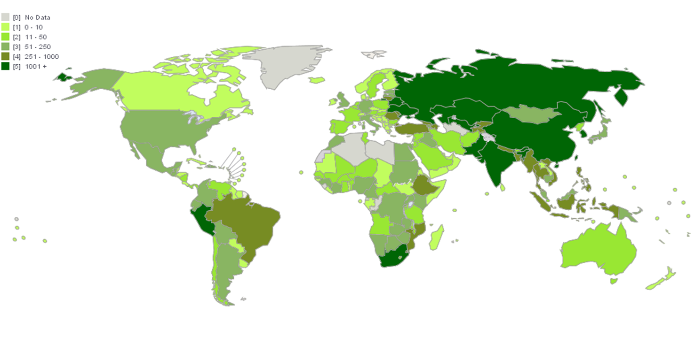
Diagnosis and Notification of MDR TB 2012

Slide 16
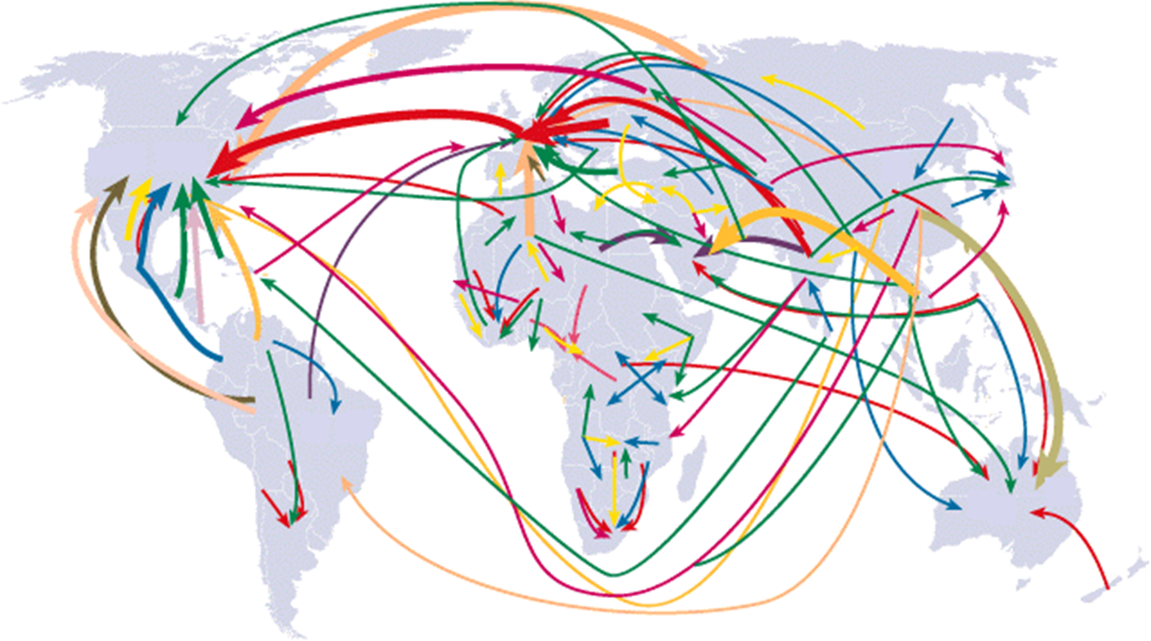
Have germs, will travel… Migrating populations in the 1990s
Notes:
This map show the travel has increased 4 fold from the 60s and 70s and note the heavist arrows – most frequent paths have US as destination. (Source: Population Action International 1994)
USING CALIF. AS THE EXAMPLE
~10 million Californians are foreign-born
~400 million crossing US Mexico border each year
~3.5 million visitors to CA
~2 million undocumented enter CA
~250,000 new entrants with perm residence visa
~100,000 new entrants with student visa
CA in particular is a major destination , 10 million of 35 million residents are FB. Very large volume of travel and migation for temp and perm residence. Human migration links low and high income, low and high incidence, near and far
Air is the vehicle and shared universally
There is major flow from Asia to Oceania,
SE Asia & the Middle East
Europe & the Americas & all points on the globe
The even travel to & within Africa has increased
In fact the volume of migration has increased 4 times as compared with 20 to 40 years ago

Slide 17
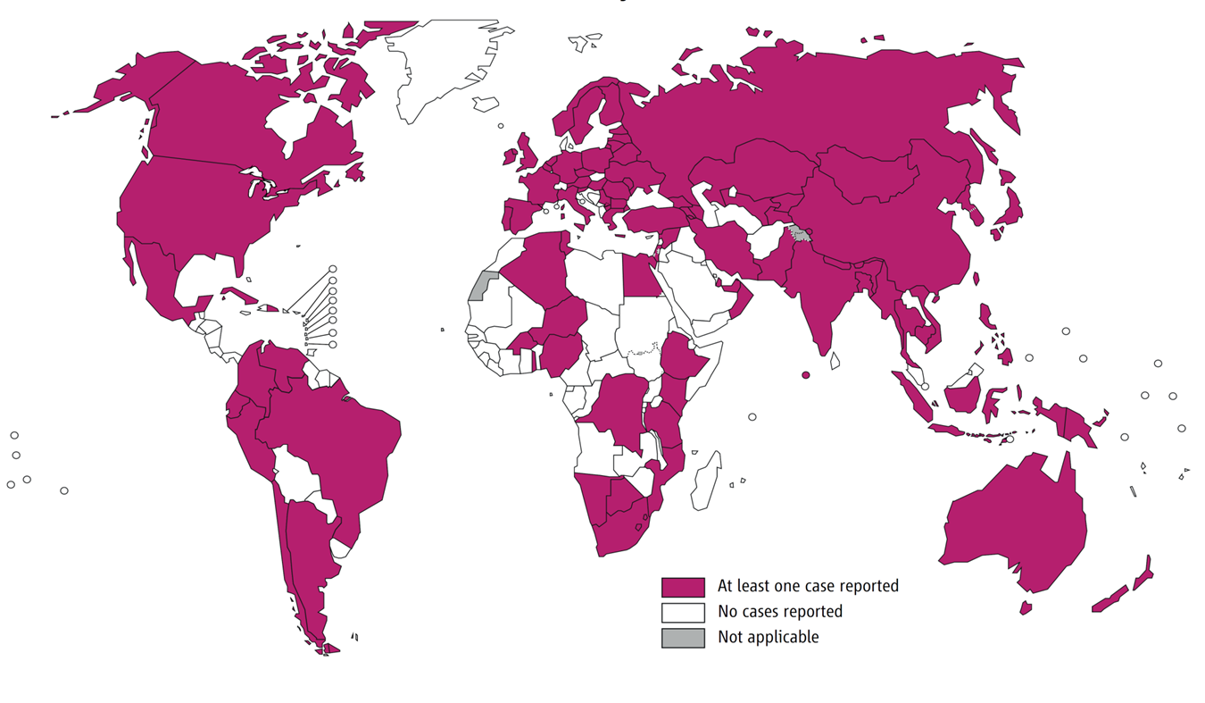
Countries that had reported at least one XDR-TB case by Oct 2013

Slide 18
Case Finding and Diagnosis of MDR TB
Similar to TB, case definitions for MDR-TB are determined by three factors: Site of disease, Severity of disease, History of previous treatment.
While all contacts to infectious TB require investigation, MDR-TB requires the most vigilance and contact investigation of XDR-TB should be considered an emergency situation.
Close contacts of MDR-TB patients should receive careful clinical follow-up. If active disease develops, prompt initiation of treatment with a regimen designed to treat MDR-TB is recommended.

Slide 19
Principles for Managing MDR TB
Directly observed treatment (DOT, also known as fully supervised treatment) for MDR-TB patients is necessary throughout the entire period of treatment.

Slide 20
Principles for Managing MDR TB
A single drug should never be added to a failing regimen
When initiating or revising therapy, always attempt to employ at least 3 previously unused drugs to which there is in vitro susceptibility
Sufficient numbers of oral drugs should be started at onset of therapy to make sure there is an adequate regimen once the injectable agent is discontinued
American Thoracic Society, Centers for Disease Control & Prevention, & Infectious Diseases Society of America, 2003
Notes:
This slide represents many of the key principles to follow when treating a patient with multiple drug resistant or XDR TB. Most of these principles were violated by providers. These principles include:

Slide 21
Principles for Managing MDR TB
Do not limit the regimen to 3 agents if other previously unused drugs that are likely to be active are available
Intermittent therapy should not be used in treating MDR TB
The use of drugs to which there is demonstrated in vitro resistance is not encouraged
American Thoracic Society, Centers for Disease Control & Prevention, & Infectious Diseases Society of America, 2003

Slide 22
Principles for Managing MDR TB
A good response does not justify continuation of an inadequate regimen
Serum therapeutic drug level monitoring should generally be utilized, especially for the bactericidal drugs and those most toxic
Resistance to RIF is associated in most cases with cross resistance to rifabutin and in all cases to rifapentine
American Thoracic Society, Centers for Disease Control & Prevention, & Infectious Diseases Society of America, 2003
Notes:
This slide represents many of the key principles to follow when treating a patient with multiple drug resistant or XDR TB. Most of these principles were violated by providers. These principles include:

Slide 23
Principles for Managing MDR TB
Consultation with an expert in the care of drug resistant tuberculosis should be sought
American Thoracic Society, Centers for Disease Control & Prevention, & Infectious Diseases Society of America, 2003
Notes:
This slide represents many of the key principles to follow when treating a patient with multiple drug resistant or XDR TB. Most of these principles were violated by providers. These principles include:

Slide 24
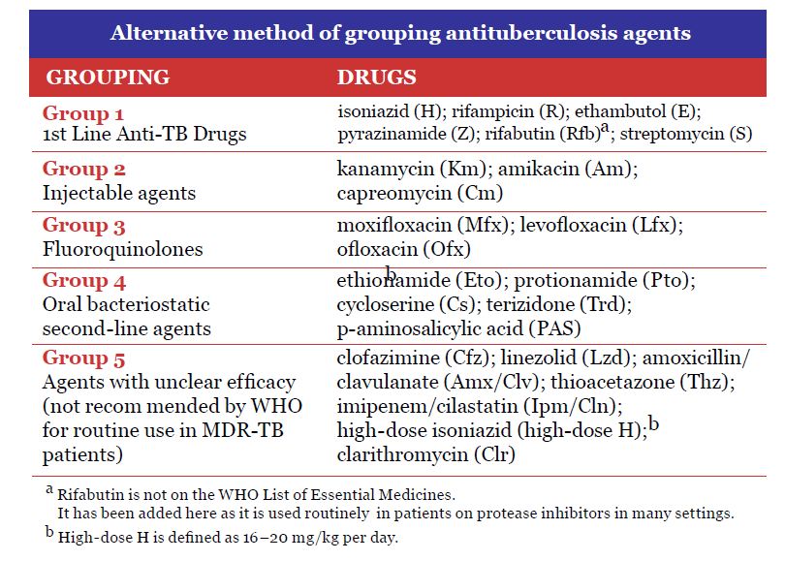

Slide 25
Treatment of Patients with MDR TB
The regimen should include:
pyrazinamide
a fluoroquinolone
a parenteral agent
ethionamide (or prothionamide), and
cycloserine, or else PAS if cycloserine cannot be used.

Slide 26
Treatment of Patients with MDR TB
Compared to first-line anti-TB drugs, second-line drugs for the treatment of MDR-TB . . .
Are much more expensive
Are less effective
Have more side effects/toxicities
Have shorter shelf life

Slide 27
Treatment of Patients with MDR TB
A total treatment duration of at least 20 months is recommended in patients not having had previous MDR treatment.
During the intensive phase of treatment, an MDR-TB patient takes at least four drugs deemed effective (including a parenteral agent), as well as pyrazinamide, should be included.
During the continuation phase, the patient takes at least four oral drugs deemed effective.
During both phases the drugs are taken daily.

Slide 28
Treatment of Patients with MDR TB
The duration of administration of the injectable agent (or the intensive phase) is guided by smear and culture conversion.
The intensive phase should be continued for at least eight months.
Culture results, chest radiograph findings and the patient's clinical status should be taken into account when deciding whether or not to continue an injectable agent for a longer period, particularly if:
susceptibility pattern is unknown.
effectiveness is questionable for an agent(s) in the regimen.
extensive or bilateral pulmonary disease is present.

Slide 29
Treatment of Patients with MDR TB
Intermittent therapy only for the injectable agent (3 times/week after an initial period of 2-3 months of daily therapy) can be considered when toxicity becomes a greater risk to the patient.

Slide 30
Is XDR TB a problem in the U.S.?
The risk of acquiring XDR TB in the United States appears to be low because XDR TB is uncommon in the U.S.
However, TB can spread easily. As long as XDR TB exists, the risk to people in the United States is not zero, and the U.S. public health system must address the threat.

Slide 31
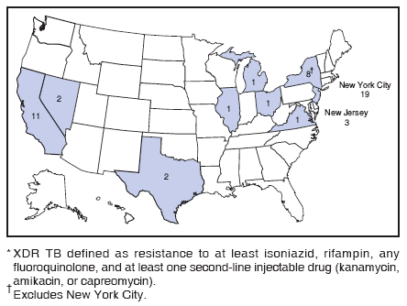
XDR TB Cases Reported in U.S. 1993 – 2006

Slide 32
Why is XDR TB so serious?
Because XDR TB is resistant to the most potent TB drugs, the remaining treatment options are less effective, have more side effects, and are more expensive.
XDR TB is of special concern for persons with HIV infection or other conditions that can weaken the immune system. These persons are more likely to develop TB disease once they are infected, and they also have a higher risk of death if they develop TB disease.

Slide 33
Can XDR TB be treated and cured?
Yes, in some cases. Some TB control programs have shown that cure is possible for an estimated 30% to 50% of affected people.
Successful outcomes depend greatly on the extent of the drug resistance, the severity of the disease, whether the patient’s immune system is weakened, and adherence to treatment.

Slide 34
What can healthcare providers do to prevent XDR TB?
Quickly diagnose TB cases
Follow recommended treatment guidelines
Monitor patients’ response to treatment
Make sure therapy is completed

Slide 35
Challenges
Even if most TB patients are not drug-resistant, the burden of MDR and XDR TB in the world poses a formidable challenge to the prospect of controlling TB.
Coverage of DST for TB patients remains low and thus a minority of drug-resistant TB patients are detected and notified.
While progress has been achieved in recent years in scaling-up MDR-TB care, only one fourth of the estimated MDR-TB patients are reported to be put on treatment.

Slide 36
Challenges (cont’d)
Treatment of MDR-TB is complicated and less effective than for drug-susceptible TB. Countries need to place more MDR-TB patients on adequate treatment.

Slide 37
Summary
Tuberculosis remains a world-wide public health problem that is pandemic in proportion.
MDR and XDR TB have emerged due to poor treatment practices and monitoring.
Drug susceptability testing, case finding, appropriate treatment and monitoring for MDR TB require special attention.
Strong consideration should be given to expert consultation or management of MDR and XDR TB.

Slide 38
Tuberculosis Conference 2014

