Slide 1
Mantoux Skin Testing Joan E. McMahon, RN, MPH Tuberculosis Educator Breathe Pennsylvania

Slide 2
The Mantoux Tuberculin Skin Test (TST)
The Mantoux tuberculin skin test is used to detect tuberculosis (TB)infection.
In the United States, it is performed by using a 27-gauge needle and syringe to inject 0.1 ml containing 5 tuberculin units of purified protein derivative (PPD) intradermally, usually on the forearm.
The reaction to this test, the induration, is measured 48 to 72 hours after the injection and is classified as positive or negative depending on the size of the induration and the person’s risk factors for TB.

Slide 3
The Mantoux Tuberculin Skin Test (TST)
History
Mantoux TST first developed and described by German physician Felix Mendel in 1908
Named for French physician, Charles Mantoux, who started widely using the test in 1908 and conducted extensive research on TB

Slide 4
How Is The TST Reaction Interpreted?
Depends on two factors:
1. Measurement of the induration in millimeters
2. Individual’s risk of being infected with TB and of progression to disease if infected
TST reactions are classified according to cut points (5mm, 10mm, 15mm) according to the person’s risk factors
A positive TST means the person’s body was infected with TB bacteria
Additional tests (such as a chest x-ray and sputum culture) are needed to determine if the person has latent TB infection or TB disease
A NEGATIVE TST means that the person’s body did not react to the test, and that latent TB infection or TB disease are not likely

Slide 5
Should Everyone Be Tested for TB?
No, TB tests are generally not needed for people at low risk of infection with TB bacteria
Follow–up measures should always be in place when testing is initiated

Slide 6
Who Should Be Tested For TB?
Persons who have spent time with someone who has TB disease
Those with HIV infection or another medical problem that weakens the immune system
People who have symptoms of TB disease (fever, night sweats, persistent cough and unexplained weight loss)
Immigrants from a country where TB disease is common (most countries in Latin America, the Caribbean, Africa, Asia, Eastern Europe, and Russia)
Residents or workers in places where TB disease is more common (e.g., homeless shelters, prisons, some nursing homes)
Individuals who use illegal injectable drugs

Slide 7
What About Persons Who Have Been Previously Vaccinated With Bacille Calmette-Guerin (BCG) Vaccine?
May receive a TST
In some persons, BCG may cause a positive skin test when they are actually not infected with TB bacteria
If the TST is positive, medical follow-up is needed to rule out possible TB disease

Slide 8
How is the TST Administered?
Administered by injecting 0.1 ml of tuberculin purified protein derivative (PPD) intradermally into the inner surface of the forearm
A tuberculin syringe with a 27 gauge needle should be used, with the needle facing up
When placed correctly, the injection should produce a wheal 6-10 mm in diameter

Slide 9
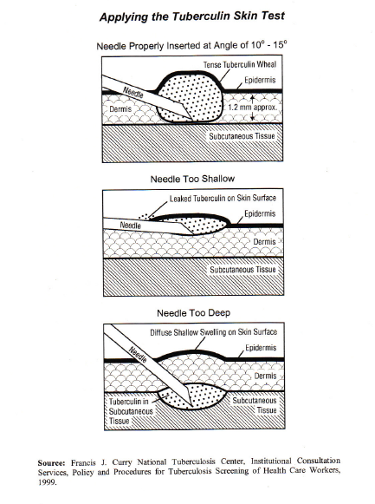
Applying the TST

Slide 10
How is the TST Read?
TST reaction should be read between 48 and 72 hours after administration
A person who does not return within 72 hours will need to be rescheduled for another TST
Reaction should be measured in millimeters of induration (palpable, raised, hardened area)
Erythema (redness) should not be measured
Diameter of the indicated area should be measured across the forearm (perpendicular to the long axis)

Slide 11
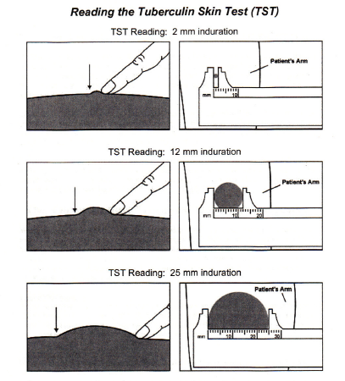
Reading the TST

Slide 12
What Are False Positive Reactions?
Some persons may react to the TST even though they are not infected with M. Tuberculosis
Causes:
Infection with non-tuberculin mycobacteria
Previous BCG vaccination
Incorrect method TST Administration
Incorrect interpretation of the reaction
Incorrect antigen used

Slide 13
What are False Negative Reactions?
Some people may not react to the TST even though they are infected with M. Tuberculosis. The causes of these false negative reactions may include, but are not limited to the following:
Anergy (the inability to react to skin tests due to a weakened) immune system
Recent TB infection (within 8-10 weeks of exposure)
Very old TB infection (many years)
Very young age (less than 6 months old)
Recent live virus vaccination (e.g. measles, MMR)
Overwhelming disease
Some viral illnesses (e.g. measles, chicken pox)
Incorrect method of TST Administration
Incorrect interpretation of reaction

Slide 14
Who Can Receive a Test?
Most persons can receive a TST
Contraindicated only for persons who have had a severe reaction (e.g., necrosis, blistering, anaphylactic shock, or ulceration) to a previous TST.
Not contraindicated for any other persons, including infants, children, pregnant women, HIV infected individuals, or persons who have been vaccinated with BCG.

Slide 15
What is a Boosted Reaction?
In some individuals who are infected with M. tuberculosis, the ability to react to the TST may wane over time.
When such a person is given a TST, the individual may initially have a false negative reaction. However, the test may stimulate the immune system, causing a positive reaction to subsequent TSTs, falsely indicating a recent TB infection when, in fact, the individual was previously positive.

Slide 16
What is Two-Step Testing and Why is it Conducted?
Giving a second TST approximately 1 to 2 weeks after an initial negative TST reaction is called two-step testing
It is useful for the initial skin testing of adults who are going to be retested periodically such as health care workers or nursing home residents
Two-step approach can reduce likelihood that a boosted reaction to a subsequent TST will be misinterpreted as a recent infection

Slide 17
Can TSTs be Administered to Persons Receiving Vaccinations?
Vaccination with live viruses may interfere with TST reactions
Therefore, TSTs should be administered either on the same day as vaccinations with live virus vaccines
OR, 4-6 weeks after the administration of the live virus vaccine
TSTs should be administered at least one month after smallpox vaccination

Slide 18
Care of the PPD Testing Solution
Liquid PPD is sensitive to light and temperature and may become unstable if held in plastic syringes
Should be stored in cool environment between 35 and 46 degrees Fahrenheit
PPD vial should be dated upon opening, and the remainder discarded after 30 days, regardless of expiration date
Syringes should not be prefilled in anticipation of demand, but filled at time of need

