Slide 1
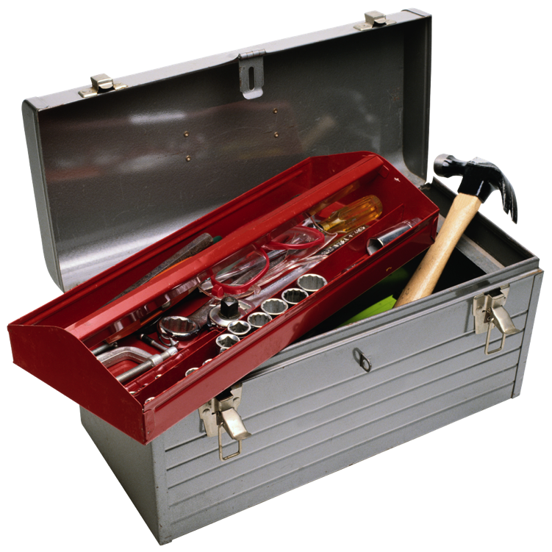
New Tools for Diagnosing Latent TB
Christine M. Litwin, M.D.
Professor, Pathology and Laboratory Medicine
Medical Director, Clinical Immunology and Referral Testing
Medical University of South Carolina
Charleston, South Carolina

Slide 2
  Faculty Disclosure Information
  Dr. Christine M. Litwin, M.D.
  Disclosure of Relevant Financial Relationships:
  I have the following financial relationships to disclose:
  Speakers Bureau for: QIAGEN, Inc.

Slide 3

Objectives
Be able to interpret the results of the interferon gamma release assays (IGRAs) and recognize the causes of indeterminant results
Recognize the advantages and disadvantages of TB skin testing (TST) and IGRAs for the diagnosis of latent TB infection

Slide 4
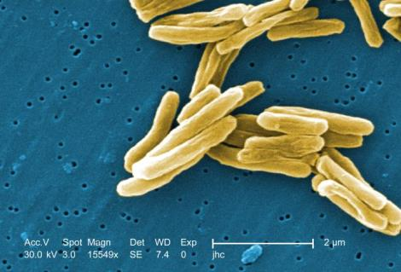
Global Impact and Burden of TB
30% of World’s population (2 billion) is infected
Almost 9 million new TB cases per year
  1 new infection every second!
1.5 million TB deaths per year
  Someone dies of TB in the world
  every 17 seconds
TB continues to be a major health problem worldwide
1. WHO Global Tuberculosis Report 2014
Notes:
TB continues to be a major health problem worldwide

Slide 5
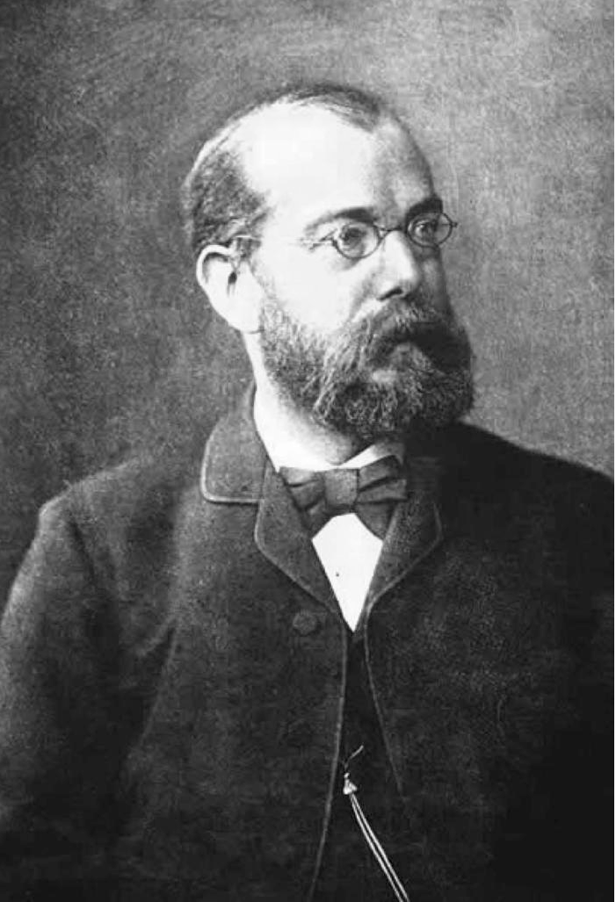
Why We Need New Tools to Fight TB
PPD skin test >100 years old and lacks specificity
Sputum microscopy>100 years old and lacks sensitivity
Culture remains the gold standard
Nucleic amplification assay: takes 3 samples for 90% sensitivity
BCG vaccine > 85 years old
Dr. Robert Koch 1843-1910
Notes:
TB continues to be a major health problem worldwide

Slide 6
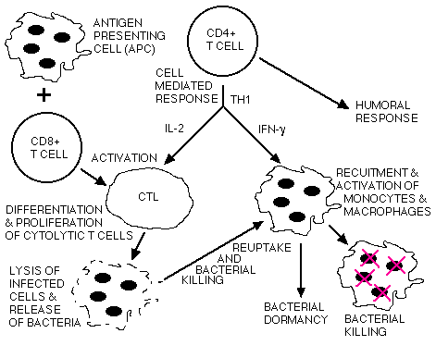
Immunology of TB
Activation by CD4+ T_{DTH} cells enable the macrophages to destroy bacilli
TH1 cells produce the cytokines IFN-γ and IL-2
IFN-γ specifically activates macrophages and stimulates them to ingest and kill mycobacteria
IFN-γ Basis of the QFT-TB test

Slide 7
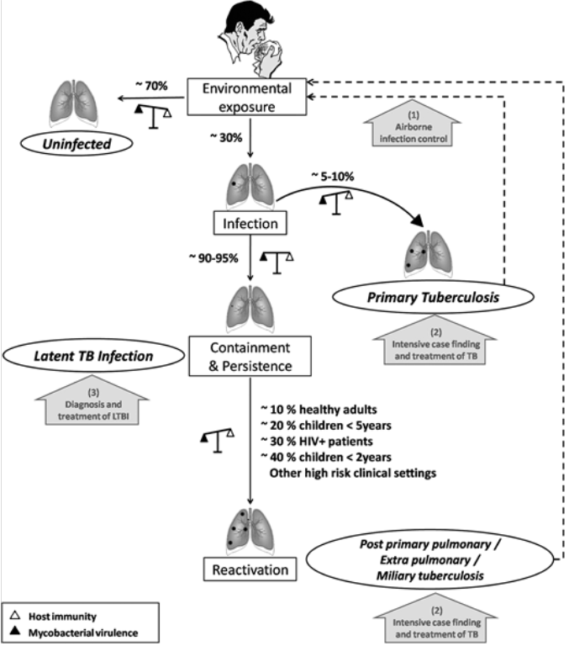
  Transmission & Natural History of
  M. tuberculosis
~70-80%
Exposure
(1)
Airborne Infection Control
Uninfected
~20-30%
~5-10%
Infection
Airborne transmission
20-30% of exposed will become infected
5-10% of infected will develop active TB
90-95% of infected will develop latent TB
Those infected with LTBI may reactivate!
Active TB
~90-95%
(2)
Case finding and treatment of TB
Latent TB
Containment
(3)
Diagnosis and treatment of LTBI
~10% healthy adults
~20% children <5 yrs
~30% HIV+ patients
~40% children <2 yrs
Other high risk
clinical settings
Post primary pulmonary/
Extra pulmonary/
Miliary TB
Reactivation
Host immunity
(2)
Case finding and treatment of TB
Mycobacterial virulence
  Adapted from: Chest. 2012;142(3):761-773. doi:10.1378/chest.12-0142

Slide 8
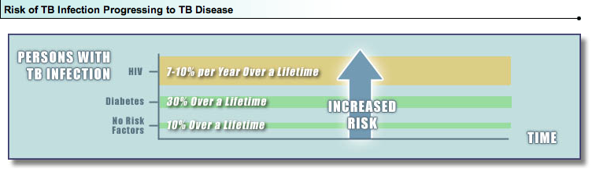
Risk of TB Infection Progressing to TB Disease

Slide 9
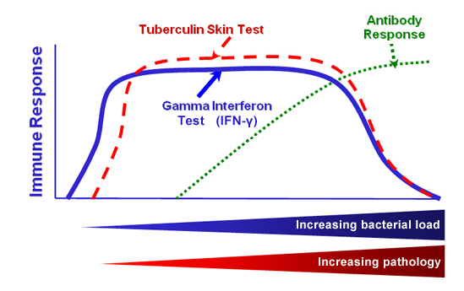
Immune Response to TB Infection and Disease
Active TB

Slide 10
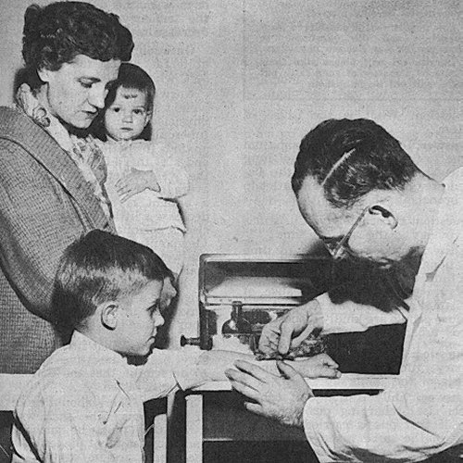
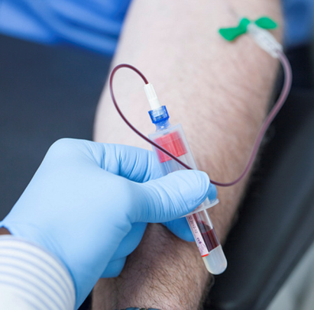
  Diagnostic Tools for TB Infection
  Tuberculin Skin Test (TST)
  Interferon Gamma Release Assays (IGRAs)
Notes:
No gold standard for diagnosis of LTBI
No test can discriminate between active and latent disease
Typically only performed if the patient has an increased risk of being infected (e.g. foreign born) or is at risk of developing active TB disease (e.g. immunosuppressed)

Slide 11
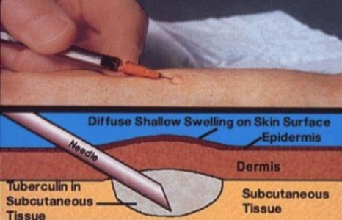
  Tuberculin Skin Test (TST)
Indirect test for detection of M. tuberculosis – in vivo
  Type IV cell-mediated immune response to M. tuberculosis
Requires trained and experienced personnel¹
Intradermal injection of tuberculin (PPD), with assessment for presence of skin induration in 2-3 days
1. AAP IGRA technical report by Jeff Starke 2014 Dec

Slide 12
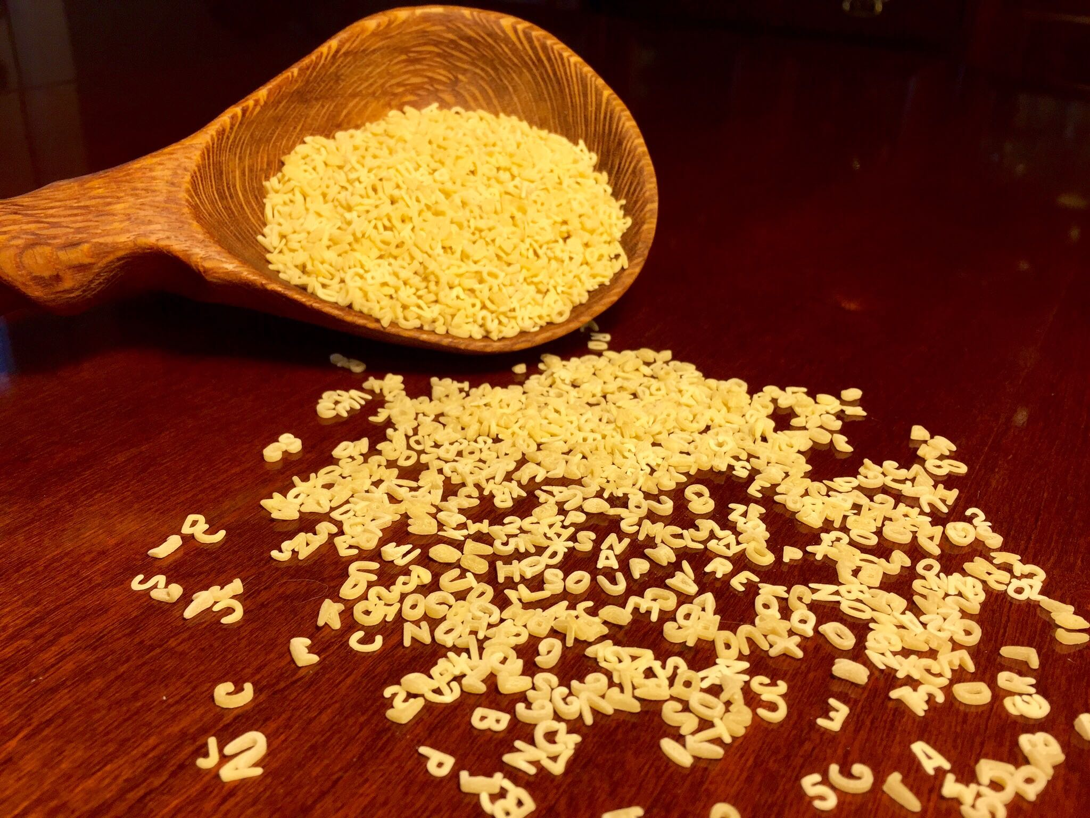
PPD = Alphabet Soup of Antigens
Notes:
What is PPD? Basically, think of it as antigen soup. It is not specific solely to M. tuberculosis.
And as a result, we often see false results… (next slide)

Slide 13
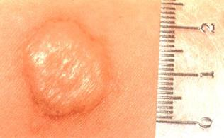
  TST Limitations: False Results
False positive results due to:
BCG vaccination
Immune reactivity to non-tuberculosis mycobacteria (NTMs)
In US-born individuals, up to 50% of TST responses can be due to NTM infections¹
False negative results due to:
Improper intradermal injection of PPD
Improper storage
Reading error
Malnourishment
Infections
Steroids
Renal Failure
Burns
Age
Immunocompromised
1. von Reyn CF et al. (2001) Int J Tuberc Lung Dis 5 (12), 1122-1128.

Slide 14
  TST Limitations: False Results
False positive results due to:
BCG vaccination
Immune reactivity to non-tuberculosis mycobacteria (NTMs)
In US-born individuals, up to 50% of TST responses can be due to NTM infections¹
False negative results due to:
Improper intradermal injection of PPD
Improper storage
Reading error
Malnourishment
Infections
Steroids
Renal Failure
Burns
Age
Immunocompromised
DISSEMINATED TB DISEASE
1. von Reyn CF et al. (2001) Int J Tuberc Lung Dis 5 (12), 1122-1128.

Slide 15
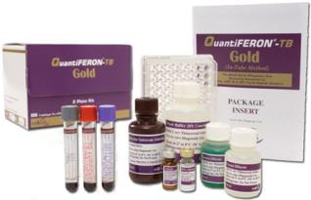
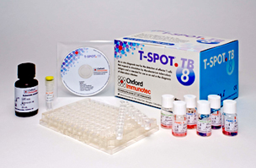
  IGRAs
Blood tests for tuberculosis (TB) – ex vivo
  QuantiFERON®-TB Gold (QFT®) → ELISA-based
  T-SPOT®.TB → ELISPOT-based IGRA
Indirect detection of TB bacterial infection
  Measure secretion of cytokine interferon-gamma (IFN-γ) by lymphocytes stimulated in vitro with TB-specific antigens
Like the TST, IGRAs do not specify active or latent TB
Notes:
Make mention of the fact that the T-SPOT currently available on the market is often shipped out to the manufacturer’s central lab where they add a substance called Xtend. This version of the test with Xtend was not available until after the CDC guidelines on IGRA use were published. And the data available on it shows it negatively impacts performance. For this reason, I go with QFT.

Slide 16


  Guidelines
IGRA may be used in place of (but not
in addition to) a TST in all situations in
which CDC recommends TST as an aid in diagnosing M. tuberculosis infection
Centers for Disease Control and Prevention. Updated Guidelines for Using IGRAs to Detect M. tuberculosis Infection. MMWR 2010;59(RR-5):1-27.
MMWR. CDC 2010

Slide 17
  Guidelines
IGRA is preferred, but TST is acceptable:
  Patient is unlikely to return for TST result reading
  Patient has received BCG (as vaccine or for cancer therapy)
TST is preferred, but an IGRA is acceptable:
  Children <5 years old
    Use of an IGRA in conjunction with TST has been advocated by some experts to increase diagnostic sensitivity in this age group
Centers for Disease Control and Prevention. Updated Guidelines for Using IGRAs to Detect M. tuberculosis Infection. MMWR 2010;59(RR-5):1-27.
MMWR. CDC 2010

Slide 18
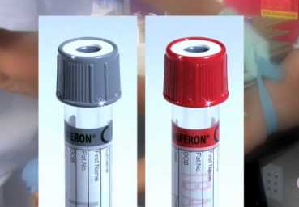
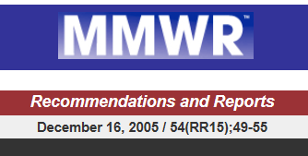
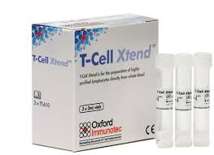
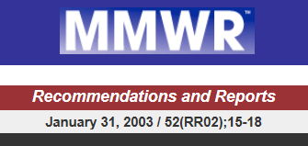
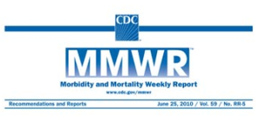
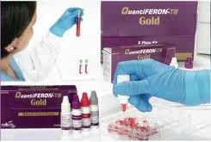
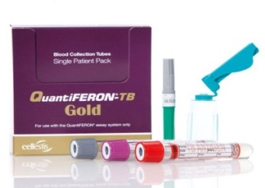
Timeline: IGRAs and IGRA Guidelines
FDA approval
QuantiFERON®-TB
(QFT)
CDC releases
Guidelines for
Using QFT-G
FDA approval
T-Cell Xtend®
FDA approval
T-SPOT®.TB
28 Nov 2001
16 Dec 2005
30 Jul 2008
9 Jul 2010
31 Jan 2003
2 May 2005
10 Oct 2007
25 Jun 2010
CDC releases
Guidelines for
Using QFT
FDA approval
QuantiFERON®-TB
Gold
(QFT-G)
FDA approval
QuantiFERON®-TB
Gold In-Tube
(QFT-GIT)
CDC releases
Updated Guidelines
on Using IGRAs
Notes:
Xtend was not available when the studies for the 2010 guidelines were published.
Different Product!

Slide 19
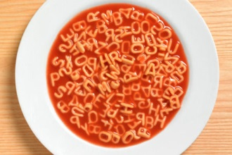
IGRA Antigens are Specific for M. tuberculosis
Antigens detected by each IGRA:
QFT detect ESAT-6, CFP-10 and TB7.7
T-SPOT detects ESAT-6 and CFP-10
?
CFP-10
CFP-10
CFP-10
ESAT-6
TB7.7
ESAT-6
TB7.7
ESAT-6
TB7.7
M. bovis BCG
M. tuberculosis
M. avium and most other environmental mycobacteria
Common mycobacterial genes
Tuberculosis complex-specific genes
Deleted region
Notes:
ESAT-6, CFP-10 and TB7.7 are specific to M. tuberculosis and do not cross react with BCG or most other environmental mycobacteria

Slide 20
QFT TB Antigens Specificity vs. TST
Tuberculosis Complex | QFT TB-Specific Antigens |  |  | TST Antigens
 | ESAT-6 | CFP-10 | TB 7.7 | PPD
M. tuberculosis | + | + | + | +
M. africanum | + | + | + | +
M. bovis | + | + | + | +
BCG Substrain | QFT TB-Specific Antigens |  |  | TST Antigens
 | ESAT-6 | CFP-10 | TB 7.7 | PPD
Gothenberg | - | - | - | +
Moreau | - | - | - | +
Tice | - | - | - | +
Tokyo | - | - | - | +
Danish | - | - | - | +
Glaxo | - | - | - | +
Montréal | - | - | - | +
Pasteur | - | - | - | +
Environmental Strains (NTMs) | QFT TB-Specific Antigens |  |  | TST Antigens
 | ESAT-6 | CFP-10 | TB 7.7 | PPD
M. abcessus | - | - | - | +
M. avium | - | - | - | +
M. branderi | - | - | - | +
M. celatum | - | - | - | +
M. chelonae | - | - | - | +
M. fortuitum | - | - | - | +
M. gordonii | - | - | - | +
M. intracellulare | - | - | - | +
M. kansasii | + | + | - | +
M. malmoense | - | - | - | +
M. marinum | + | + | - | +
M. oenavense | - | - | - | +
M. scrofulaceum | - | - | - | +
M. smegmatis | - | - | - | +
M. szulgai | + | + | - | +
M. terra | - | - | - | +
M. vaccae | - | - | - | +
M. xenopi | - | - | - | +
QFT does NOT react with BCG,
nor with most NTMs!

Slide 21
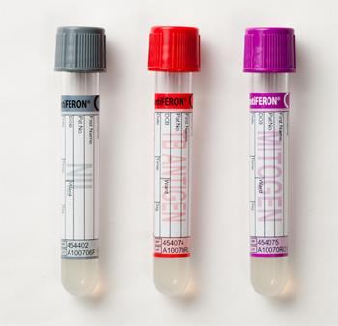
QFT Premise for Antigen Detection
NIL Tube: Negative Control
Adjusts for background noise, heterophile
antibody effects, or non-specific IFN-γ in samples
TB ANTIGEN Tube: Patient TB antigen
Coated with TB-specific antigens
(ESAT-6, CFP-10, TB7.7)
MITOGEN Tube: Positive Control
(PHA – phytohaemagglutinin)
Indicates patient’s immune status
Indicates correct blood handling and incubation
Notes:
Whole blood (1 mL) into each of three blood collection tubes. Tubes are incubated at 37oC for 16 to 24 hours. The IFN concentration in the plasma is determined using a sensitive ELISA.

Slide 22
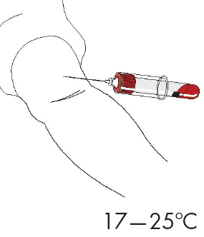
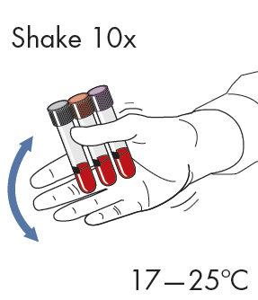
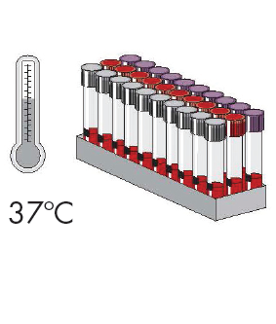
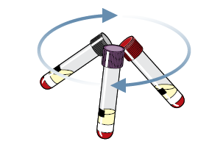
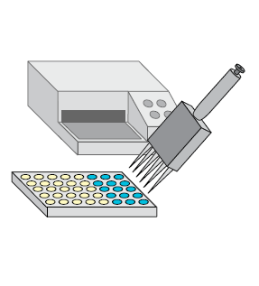
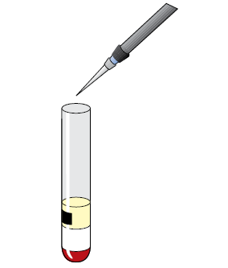
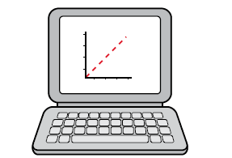
QFT Procedure
1. Blood draw
2. Shake tubes
3. Incubate
4. Centrifuge
7. Calculate results*
6. ELISA*
5. Harvest plasma
* Typically automated in lab
Notes:
The test is performed by collecting whole blood (1 mL) into each of three blood collection tubes. Blood does not have to be drawn in any specific order
Tubes are incubated at 37ºC for 16 to 24 hours. The IFN concentration in the plasma is determined using a sensitive ELISA.
Automation and quantification limits variability

Slide 23


QuantiFERON Test Method
COLOR
TMB
*
*
*
Incubate overnight 37ºC
TB infected individuals respond by producing Interferon-γ
Harvest Plasma
Incubate 120 minutes in“Sandwich” ELISA
Wash, Add substrate, Develop color

Slide 24
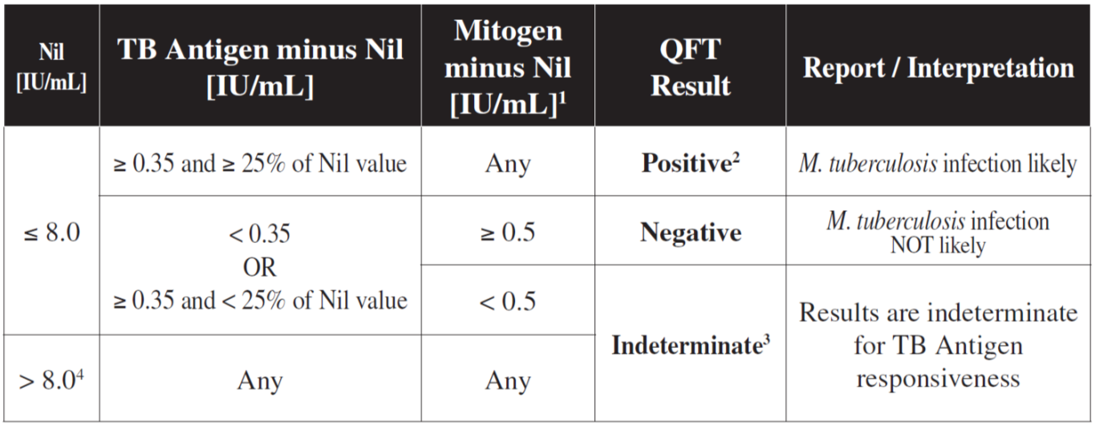
Interpretation of QFT Results
As recommended by CDC guidelines, request both the standard qualitative test interpretation and the quantitative assay measurements

Slide 25
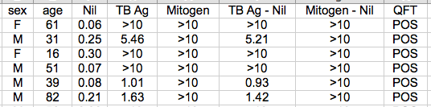
Typical Positive QFT Results
Comment: In patients where there is a low risk of exposure to M. tuberculosis and the value of the QFT assay is between 0.35 IU/mL-1.11 IU/mL, repeat testing in one month may be recommended to confirm positive results.
Thanassi et al. Pulmonary Medicine 2012: 291-294.

Slide 26
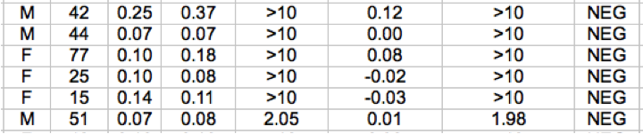
Typical Negative QFTs

Slide 27
Example of Indeterminant Values
Hi Nil
Low Mitogen

Slide 28
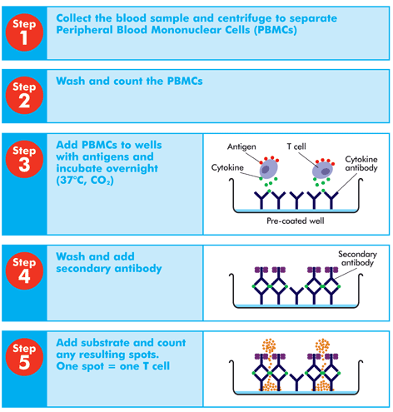

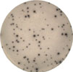


T-SPOT®.TB
Nil Control
Infection
Infection
Positive Control
Oxford Immunotec

Slide 29
Sensitivity & Specificity: QFT vs. T-SPOT vs. TST
QFT-IT
T-Spot TB
T-Spot TB
Latent
TST
QFT-IT
TST (BCG vaccinated)
90
96
(99 no risk)
59
56
65
80
83
89
81
83 81
Active
True Positive
100%
TST
QFT-IT
QFT-IT
TST
T-Spot TB
T-Spot TB
Sensitivity
Specificity
Mazurek GH et al. , 2010. MMWR. 5: 1-29
QuantiFERON-TB Gold Package Insert, March 2013
Diel meta analysis Chest 2009
Pai et al 2008

Slide 30
  IGRAs in Children
Limited number of studies exist IGRAs in children <5 years
  Rates of progression from latent infection to active disease are much higher
Indeterminate rates (due to low mitogen) are much more frequent in children <5
  Lack of immunologic maturity?
In one study of children aged 4 months--7 years, estimates of sensitivity for TST, QFT-GIT, and T-Spot were comparable at 100%, 93%, and 93% respectively
In contrast, a recent study in Africa cites sensitivity for the IGRA was no different than TST
  IGRA sensitivity was reduced in high-burden TB settings (Africa) compared with low-burden TB settings (Tsiouris et al.)
  Consider using both TST and IGRA when testing high risk children
ª A positive result for either test is considered significant in these groups.
MMWR. CDC 2010

Slide 31

  AAP Guidelines on Use of IGRAs in Children
Basics:
TST is preferred, but an IGRA is acceptable:
  Children <5 years oldª
IGRA is preferred, but TST is acceptable:
  Children ≥ 5 years of age who have received BCG vaccine
  Children ≥ 5 years of age who are unlikely to return for a TST reading
ª A positive result for either test is considered significant in these groups.
MMWR. CDC 2010

Slide 32
  AAP Guidelines on Use of IGRAs in Children
Special cases:
Both an IGRA and TST should be considered:
  The initial and repeat IGRA are indeterminate
  The initial test (TST or IGRA) is negative and:
    Clinical suspicion for TB disease is moderate to high^{b}
    Risk of progression and poor outcome is high^{b}
  The initial TST is positive and:
    >5 years of age and history of BCG vaccination
    Additional evidence needed to increase compliance
    Nontuberculous mycobacterial (NTM) disease is suspected
^{b} IGRAs should not be used in children < 2 years of age unless tuberculosis disease is suspected. In children 2 through 4 years of age, there are limited data about the usefulness of IGRAs in determining tuberculosis infection but IGRA testing can be performed if tuberculosis disease is suspected.

Slide 33
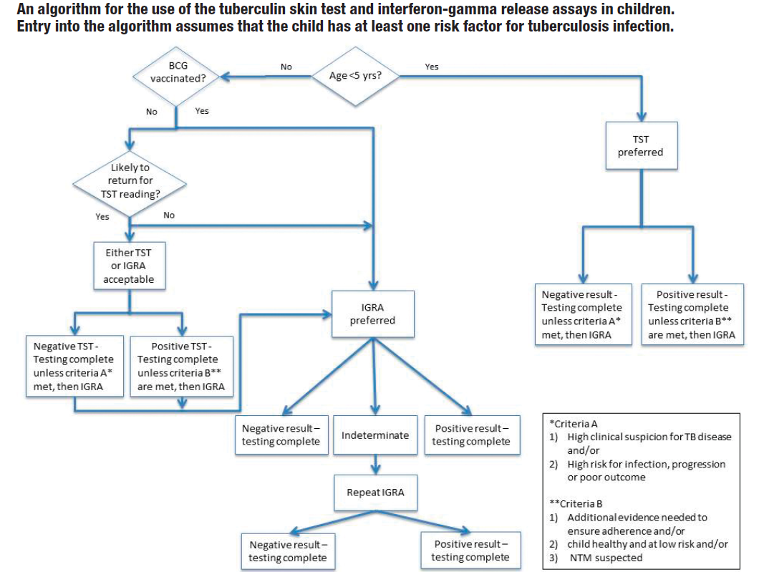
  Algorithm For Use of TST and IGRAs In Children with a Risk Factor for TB Infection
Starke JR. Report compares interferon-𝛄 release assays with tuberculin skin test. AAP News. 2014;35:14.

Slide 34
  IGRAs in HIV
Patients with HIV infection are at 21-34 times increased risk for progression from LTBI to active TB (1)
  Because there is no ‘gold standard’ for LTBI, sensitivity comparison of IGRAs is difficult (2)
  Studies in HIV-infected populations have shown
    IGRAs are less sensitive in HIV-infected patients vs HIV-uninfected (3, 5, 7)
    IGRAs cannot rule out active TB
  However, several studies have also shown that
    IGRAs are more sensitive for LTBI than the TST in HIV-infected patients (3, 5)
    IGRAs contain internal positive controls which assist discrimination between true and false negative TB results (3)
    IGRAs are not affected by BCG vaccination for LTBI testing in low TB prevalence settings (6)
    Single visit of IGRAs overcomes the TST issue of poor return rates (3, 4)
World Health Organization
Moon et al (2013) Annals of Clin & Laboratory Science
3. Hoffmann et al (2010) European Infectious Disease
4. Cheallaigh et al (2013) PlOs One 8(1)
5. Ramos et al (2012) BMC Infectious Diseases
6. Wolf et al (2013) J Infect
7. Aabye et al (2009) PlOs One 4(1)
MMWR. CDC 2010

Slide 35
  Is There a Role For IGRAs in Diagnosing Active TB or Predicting Progression to Active TB?
  A positive IGRA does not distinguish latent TB infection from active TB disease
  However…
  In patients with extrapulmonary TB,
  Patients who test negative for AFB in sputum or by culture
  In children,
  or in the differential diagnosis of NTM,
  IGRAs may provide useful supplementary information.
  Overwhelming active TB infection may suppress the cellular immune response and cause a negative IGRA or TST result.
MMWR. CDC 2010

Slide 36
  IGRAs Summary
Advantages
Limitations
Single Patient Visit
Not subject to reader bias
Unaffected by BCG (specificity >96%)
More accurate than TST in immune suppressed; HIV+ may be tested
More sensitive in active TB
Performs as well in children as it does in adults
Cost effectiveness in reducing false-positive results; reduction in X-rays, clinical visits, unnecessary treatment
Requires a blood draw
IGRAs are more technically demanding
Preanalytical sources of variability need to be considered.
No FDA approved equivocal range for QFT-GIT
MMWR. CDC 2010

Slide 37
A 20 year old man who recently arrived from India needs to be screened for latent tuberculosis before he starts Graduate school. He states that he was told that he received the BCG vaccine in India when he was an infant. The best test for assessing latent TB with the least number of false positives is:
Tuberculin skin test
Interferon gamma release assay
Sputum culture and smear
TB PCR

Slide 38
An 18 year old woman with HIV who you suspect may not be taking her anti-retroviral drugs on a regular basis has been drawn for her routine QuantiFERON-TB test. Her test results come back reading: Indeterminant, Low Mitogen. The most likely reason for this test result is:
  A CD4 count less than 100 cells/microliter
  A recent cold
  The Interferon gamma level is just below the cut off for a positive result
  Interference with the HIV viral load

Slide 39
A High School exchange student from Uganda is taken by his U. S. sponsor family to their family practitioner to get an MMR vaccination. A week later the school asks the family to get a PPD or a QFT test on their sponsored exchange student. The QFT result comes back with a result of Indeterminant: High Nil. What is the explanation for the Indeterminant result.
  The student has HIV with a CD4 count less than 100 cells/microliter
  The Interferon gamma level is just below the cut off for a positive result.
  The background Interferon gamma level is high from the attenuated live virus vaccines.
  Interference with the HIV viral load

Slide 40
A 21 year old recent graduate from college is about to start medical school in August. Student health draws a QFT test on the student and the result comes back positive for Latent TB. The student tells the nurse that he worked his way through college cleaning aquariums and one summer got an infection on his hand and forearm from Mycobacterium marinum. The probable reason for the positive QFT test is:
The past Mycobacterium marinum infection
He has been exposed to Mycobacterium tuberculosis
He has active tuberculosis
He has an active viral infection

Slide 41
How Can an IGRA Help You?
Avoid giving a BCG-vaccinated, foreign-born college student daily INH for 9 months? YES!
Convince a parent to give their BCG-vaccinated TST+ child preventive treatment? YES!
Contact investigation screening in a large hospital in one day? YES!
Physically disabled elderly patient needing TB testing for entry into nursing home. Results with one visit? YES!
Improve sensitivity of patient TB testing prior to use of biologics such as infliximab? YES!

Slide 42
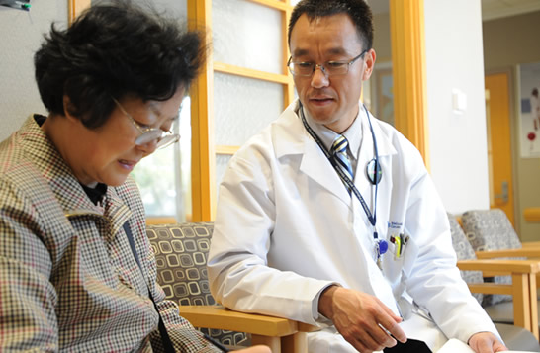
TB? Or not TB?
Protect your patients from reactivated TB!
Questions?

