Slide 1
TB and HIV Coinfection
Bruce A. Bush, M.D.
Regional Tuberculosis Consultant
Pennsylvania Department of Health
Senior Vice President for Medical Affairs
Indiana Regional Medical Center

Slide 2
Disclosures
I do not have any financial arrangements or affiliations with a commercial entity.

Slide 3
Objectives
Understand the threat posed by TB for those living with HIV infection.
Describe the treatment of drug-susceptible TB disease in people infected with HIV.
Understand the management of drug interactions in the treatment of HIV-related TB

Slide 4
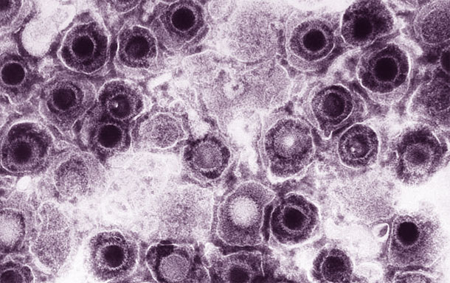
HIV

Slide 5
Definitions
HIV (human immunodeficiency virus) is a virus that attacks the immune system, the body's natural defense system. Without a strong immune system, the body has trouble fighting off disease. Both the virus and the infection it causes are called HIV.

Slide 6
Definitions
The last stage of HIV infection is AIDS (acquired immunodeficiency syndrome). People with AIDS have a low number of CD4+ cells and get infections or cancers that rarely occur in healthy people. These can be deadly.

Slide 7
HIV in the United States
CDC estimates that 1,201,100 persons aged 13 years and older are living with HIV infection, including 168,300 (14%) who are unaware of their infection. Over the past decade, the number of people living with HIV has increased, while the annual number of new HIV infections has remained relatively stable. Still, the pace of new infections continues at far too high a level – particularly among certain groups.
Notes:
Still, the pace of new infections continues at far too high a level— particularly among certain groups.

Slide 8
HIV Incidence
The estimated incidence of HIV has remained stable overall in recent years, at about 50,000 new HIV infections per year.
Within the overall estimates, however, some groups are affected more than others.
MSM continue to bear the greatest burden of HIV infection
among races/ethnicities, African Americans continue to be disproportionately affected.

Slide 9
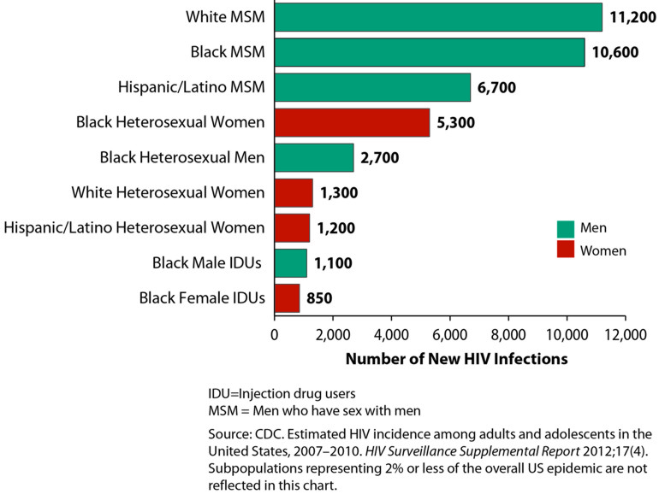

Slide 10
HIV Incidence and Prevalence
In 2012, an estimated 47,989 people were diagnosed with HIV infection in the United States.
In that same year, an estimated 27,928 people were diagnosed with AIDS.
Overall, an estimated 1,170,989 people in the United States have been diagnosed with AIDS.

Slide 11
HIV Deaths
An estimated 13,834 people with an AIDS diagnosis died in 2011
Approximately 648,459 people in the United States with an AIDS diagnosis have overall.
The deaths of persons with an AIDS diagnosis can be due to any cause – that is, the death may or may not be related to AIDS.

Slide 12
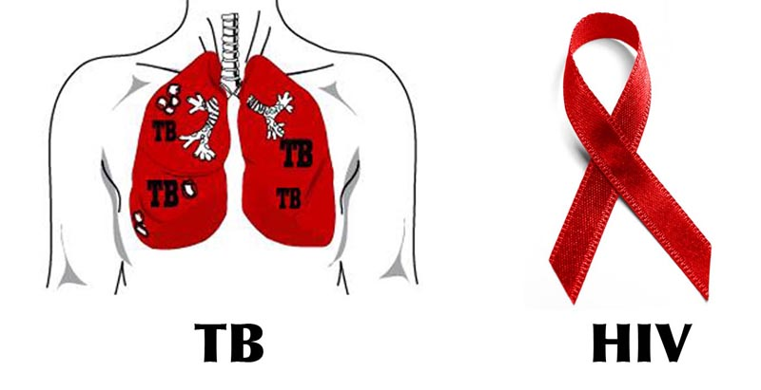
HIV and TB Co-epidemic

Slide 13
A Co-Epidemic
HIV and tuberculosis (TB) are so closely connected that their relationship is often described as a co-epidemic.
In the last 15 years the number of new TB cases has more than doubled in countries where the number of HIV infections is also high.

Slide 14
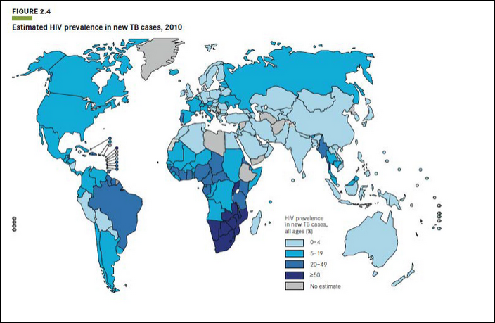

Slide 15
A Co-Epidemic
The World Health Organization (WHO) estimates 11.4 million people worldwide are infected with both Mycobacterium tuberculosis (Mtb) and HIV
The primary cause of death in those infected with both microbes is from TB, not AIDS.
In the United States, health experts estimate about two out of ten people who have TB are also infected with HIV.

Slide 16
A Co-Epidemic
One of the first signs that a person is infected with HIV may be that he or she suddenly develops TB. This form of TB often occurs in areas outside the lungs, particularly when the person is in the later stages of AIDS.
It is much more likely for people infected with Mtb and HIV to develop active TB than it is for someone that is infected only with Mtb.

Slide 17
High Risk!
The risk of developing tuberculosis (TB) is estimated to be between 26 and 31 times greater in people living with HIV than among those without HIV infection.

Slide 18
Latent TB Infection
Someone with untreated latent TB infection and HIV infection is much more likely to develop TB disease during his or her lifetime than someone without HIV infection.
Among people with latent TB infection, HIV infection is the strongest known risk factor for progressing to TB disease.

Slide 19
TB and HIV Statistics
The two diseases are a deadly combination; they are far more destructive together than either disease alone.
In developing countries many people infected with HIV contract TB as the first sign of AIDS.

Slide 20
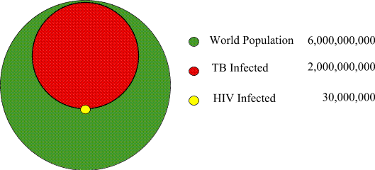
The Big Picture

Slide 21
TB and HIV Statistics
At least one-third of the 38.6 million HIV-positive people in the world are also infected with TB and are at greatly increased risk of developing TB disease (the active and contagious form of TB).
In some settings, TB kills up to half of all AIDS patients.

Slide 23
The global TB situation
Estimated incidence, 2012
Estimated number of deaths, 2012
8.6 million
(8.3–9.0 million)
940,000*
(0.8–1.1 million)
All forms of TB
1.1 million
(1.0–1.2 million)
320,000
(300,000–340,000)
HIV-associated TB
Multidrug-resistant TB
450,000 (300,000–600,000)
170,000 (100,000–240,000)
Source: WHO Global Tuberculosis Report 2013
* Excluding deaths attributed to HIV/TB
Notes:
In 2012, it was estimated that the global incidence of TB was 122 cases per 100,000 population, with most cases occurring in Asia (58%) and Africa (27%). About 450,000 new MDR-TB cases were estimated to emerge, while some 170,000 MDR-TB patients died in the same year.

Slide 24
Diagnosis
Diagnosing TB in people with HIV infection is often difficult.
They frequently have disease symptoms similar to those of TB and may not react to the standard TB skin test because their immune systems do not work properly.
X-rays, sputum tests, and physical exams also may fail to show evidence of TB infection in people infected with HIV.

Slide 25
Atypical X-Rays

Slide 26
Treatment
The standard recommendation for HIV-coinfected individuals with pulmonary TB is a 6-month course of treatment, with extension to 9 months for patients with cavitary lung disease and culture positivity at 2 months of TB treatment.
Administration of ART is recommended during TB therapy regardless of the CD4 cell count, because ART is associated with reduction in mortality and HIV disease progression.

Slide 27
ART Treatment Timing
The WHO Guidelines recommend starting antiretroviral therapy as soon as tuberculosis therapy is tolerated —specifically, as soon as possible (and within 8 weeks) of initiation of anti-TB therapy.

Slide 28
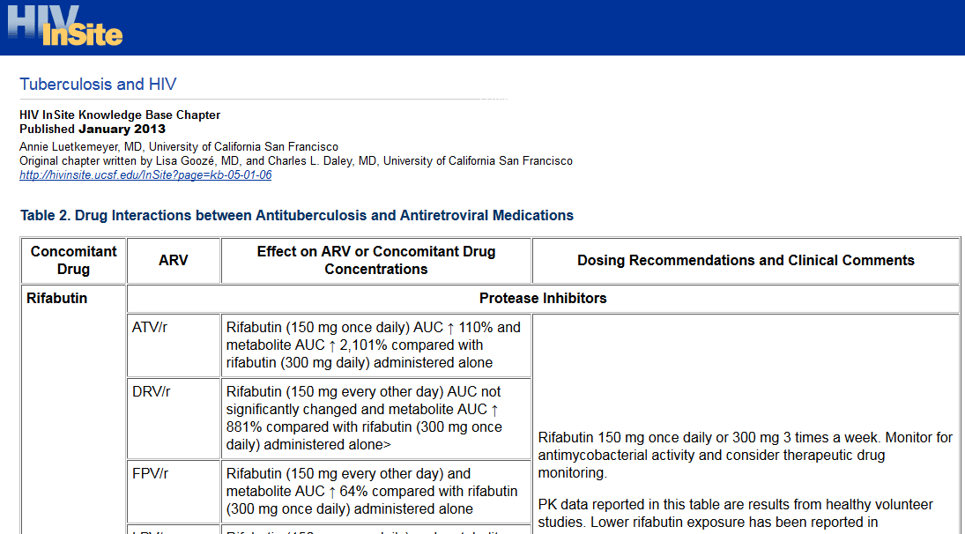
Drug Interactions

Slide 29
Case Management
Directly observed therapy (DOT) and other adherence promoting strategies should be used in all patients with HIV-related TB.
Whenever possible, the care for HIV-related TB should be provided by or in consultation with experts in management of both TB and HIV.

Slide 30
Case Management
The care for persons with HIV-related TB should include close attention to the possibility of TB treatment failure, antiretroviral treatment failure, paradoxical reactions of TB (e.g., temporary worsening of signs or symptoms of TB), side effects for all drugs used, and drug toxicities associated with increased serum concentrations of rifamycins.

Slide 31
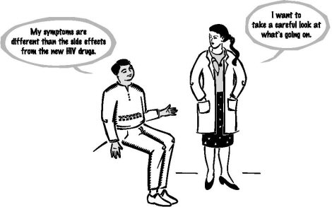
Immune reconstitution inflammatory syndrome

Slide 32
Definition
A paradoxical inflammatory reaction against a foreign antigen (alive or dead) in patients who have started antiretroviral therapy and who have undergone a reconstitution of their immune responses against this antigen

Slide 33
TB – IRIS Pathogenesis
Increased lymphoproliferative response to mycobacterium antigens in vitro
Restoration of cutaneous response to Tuberculin
Increased [Il-6], activation markers (CD38)
Associated with TNFA-308*1, IL6-174*G

Slide 34
TB – IRIS Incidence
Europe and USA
Narita et al 36% (Miami, 1998)
Wendel et al 11% (Baltimore 2001)
Breen et al 29% (London, 2004)
Breton et al 43% (Paris, 2004)

Slide 35
Risk Factors
Starting ARV’s within 6 weeks of TB treatment
Disseminated, extra-pulmonary disease
Low base line CD4 count
Rise in CD4 %
Fall in viral load
High bacillary burden?

Slide 36
Two Types
Unmasking:
refers to the initial clinical manifestations of active TB that occurs soon after ART is started; unknown to have TB at the start of ART.
Paradoxical:
refers to the worsening of TB clinical symptoms after ART is started in patients who are receiving TB treatment.

Slide 37
Timing of IRIS
Mean of 15 days after starting HAART
Up to months (years)
Syndrome lasts for 10-40+ days

Slide 38
Prognosis
Breton et al: 16 cases of TB/IRIS: 5 ‘severe’ complications
Splenic rupture
Compressive lymphadenopathy
Ureteric obstruction
Narita et al: The study found a 6-fold increased risk of subsequent TB relapse in patients who experienced IRIS during early TB treatment.

Slide 39
Differential Diagnosis
Side effects of the antiretroviral treatment
Drug fever
TB infection not responding to standard anti-TB treatment
Other concomitant infection
Failure of ART (late IRIS)

Slide 40
“Suspected TB IRIS”:
A TB patient who after starting ART develops either –
New persistent fevers (temperature >38.6°C) which last for more than 1 week without an identifiable source (e.g., urine and sputa testing, and other procedures when clinically indicated) or reason (e.g. an allergic reaction)
or marked worsening or emergence of intrathoracic lymphadenopathy, pulmonary infiltrates
or worsening or emergence of cervical adenopathies/abscesses, or worsening of other tuberculous lesions or manifestations, such as cutaneous peritoneal or central nervous system (CNS) inflammatory pathology.

Slide 41
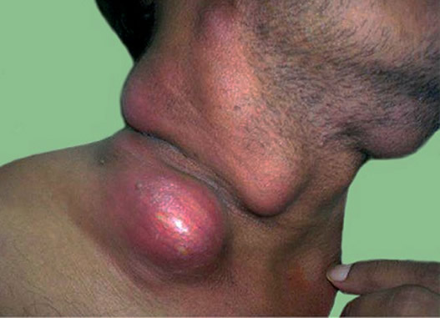

Slide 42
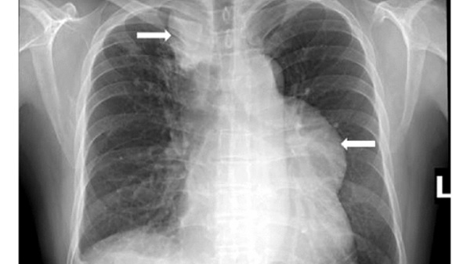

Slide 43
“Suspected TB IRIS”:
A patient who after starting ART develops TB characterised by the formation of –
Large adenopathies
Abscesses
Miliary TB with large nodules
Cavity formation

Slide 44
Confirmed TB – IRIS
Same definition as suspected TB IRIS but
multi drug resistant TB excluded
and
a satisfactory virological response to ART

Slide 45
Recommendations to Prevent TB - IRIS
Exclude TB before starting antiretroviral therapy
Treat first the TB and start antiretroviral treatment only once the patient has clinically improved, is tolerating very well his TB treatment
Increase awareness about TB IRIS

Slide 46
Treatment Recommendations
TB treatment should be continued
Exclude treatment failure
Ensure adequate treatment
Ensure adherence to ART
Consider TB drug resistance

Slide 47
Treatment Recommendations
Drainage
Continue ART in most cases
Consider stopping ARV’s if life threatening?
Adding steroids/NSAIDS may be beneficial

Slide 48
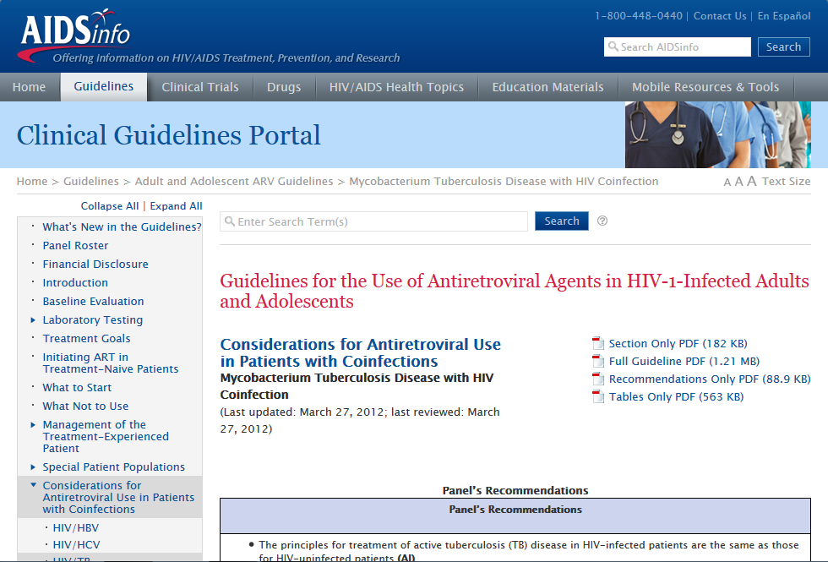
Guidelines

Slide 49
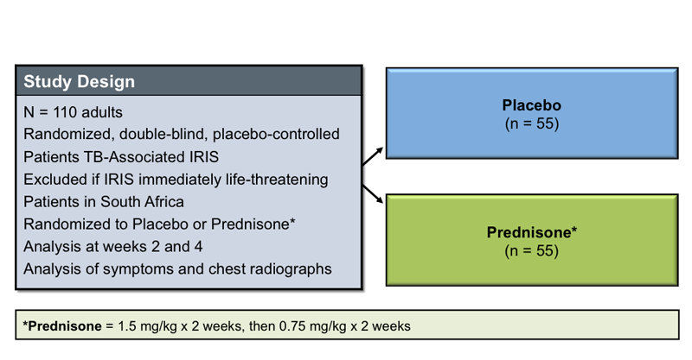
IRIS Treatment with Steroids
Source: Meintjes G, Wilkinson RJ, Morroni C, et al. Randomized placebo-controlled trial of prednisone for paradoxical tuberculosis-associated immune reconstitution inflammatory syndrome. AIDS. 2010;24:2381-90

Slide 50
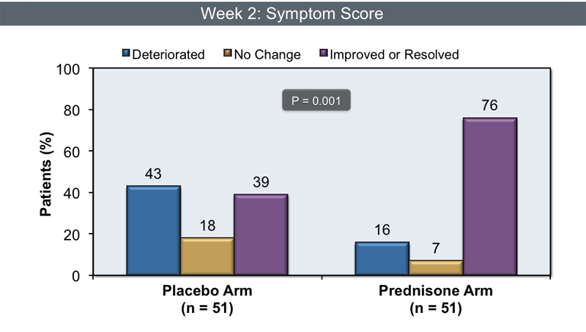
IRIS Treatment with Steroids

Slide 51
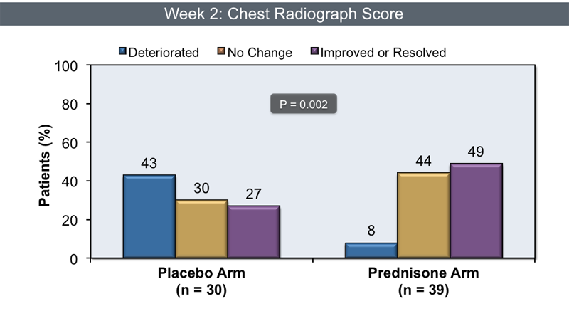
IRIS Treatment with Steroids

Slide 52
Summary
Tuberculosis (TB) and HIV have been closely linked since the emergence of AIDS.
Worldwide, TB is the most common opportunistic infection affecting HIV-seropositive individuals, and it remains the most common cause of death in patients with AIDS.
HIV infection has contributed to a significant increase in the worldwide incidence of TB.

Slide 53
Summary
By producing a progressive decline in cell-mediated immunity, HIV alters the pathogenesis of TB, leading to more frequent extrapulmonary involvement, atypical radiographic manifestations, and paucibacillary disease, which can impede timely diagnosis.
Interactions between HIV and TB medications, overlapping medication toxicities, and immune reconstitution inflammatory syndrome (IRIS) complicate the cotreatment of HIV and TB.

Slide 54
Summary
The management of HIV-related tuberculosis (TB) disease is complex. Although the treatment of TB in people with HIV is essentially the same as for patients without HIV, there are some important differences.

Slide 55
Tuberculosis Conference 2015

