Slide 1
Tuberculosis: Think Globally And Act Locally”
Breathe Pennsylvania 2016 Tuberculosis Education Conference
April 29, 2016
Pittsburg, PA
Ed Zuroweste, MD
Chief Medical Officer
Migrant Clinicians Network

Slide 2
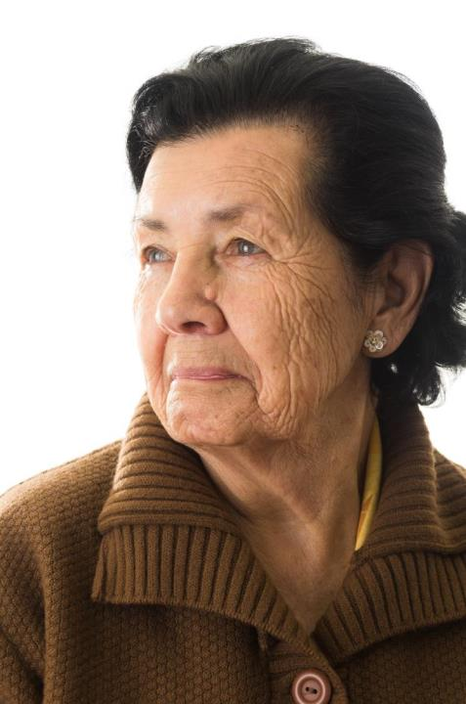
71 year old female with recurrent productive cough 7/2/15 abnormal CXR and CT scan that revealed RLL nodule (13mm) and Bilateral upper lobe infiltrates
7/16/15

Slide 3
Following a Mobile Patient: 2015-2016
Bronchoscopy with biopsies revealed no cancer cells, AFB negative smear. Felt to be “inflammatory process”
7/15
7/22
Patient left US to visit family in Europe to return to US on August 11, 2015
AFB seen on enrichment broth
8/3
8/6
DNA probe positive for MTB. Patient placed on DNB (Do not Board) list by CDC Global Migration/Quarantine
Health Network notified by LA Quarantine Station and contacted by patient’s son to enroll patient and find TB clinic in Europe. Consent form received, medical records received from patient’s hospital. TB clinic found in Europe, appt made for 8/13/15. Medical records sent.
8/12
8/13
Patient kept appt. at TB clinic, medical records reviewed by clinician and patient started on RIPE that day. Three early morning sputum samples requested
Sensitivities revealed “low level INH resistance” Do not need to adjust treatment
8/17
8/19
Airline “Fee waiver letter” sent by CDC Global Migration/Quarantine so that patient would not have to pay to rebook flight. All three smears were negative for AFB. Patient removed from DNB list.
Patient flew back home to resume treatment on August 21, 2015
8/20
2/19
Patient completed her 6 month treatment for TB without difficulty

Slide 4
15 clinic calls
11 patient calls
44 pages of medical records sent to two locations

Slide 5
“Tuberculosis is a social problem with a medical aspect”
Sir William Osler, 1904

Slide 6
Global Burden
Of Tuberculosis

Slide 7
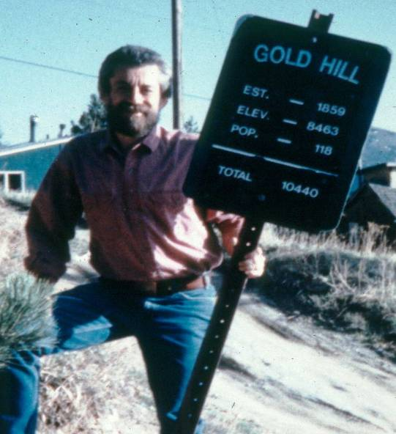
Beware of data….

Slide 8
Global Burden of TB, 2015 WHO Global TB Report, 2015
 | Estimated Number of Cases | Estimated Number of Deaths
All forms of TB | 9.6 million | 1.5 million*
HIV-Associated TB | 1.2 million (12%) | 400,000
Multidrug-resistant TB (MDR-TB) | 480,000 | ~150,000
Approx. 1/3 of the world (2 billion people) is infected with M.tb
Estimated that 43 million lives were saved between 2000 and 2014 through effective diagnosis and treatment
*In Children 1,000,000 cases and 140,000 deaths a year
**Fewer than 25% of those thought to have MDR TB were detected
*including deaths among PLHIV
Notes:
In 2014 there were 1.2 million deaths from HIV 0.4 million of those was from TB this is the first year in the past two decades that TB deaths surpassed HIV deaths

Slide 9
2015 Tuberculosis Surpassed HIV as the Leading Cause of Death by Infectious Disease

Slide 10
TB causes more deaths among women than all causes of maternal mortality
Every day 20,000 people develop TB disease and 4,400 die (< 12,000 Total Ebola Deaths)
Each year over 9 million people around the world become sick with TB disease.
On average, one person dies of TB every 15 seconds
TB accounts for more than ¼ of all preventable adult deaths in developing countries
Notes:
In children there are 1,000,000 cases a year and 140,000 deaths

Slide 11
Estimated TB Burden, 2014 22 high burden countries*
 | # of new cases |  | # of new cases
1. India (17.5%) | 1,683,915 | 12. Vietnam | 102,087
2. Indonesia (10.4%) | 1,000,000 | 13. Nigeria | 91,354
3. China (8.6%) | 826,155 | 14. Kenya | 89,294
4. South Africa | 318,193 | 15. Brazil | 81,512
5. Pakistan | 316,577 | 16. Thailand | 71,618
6. Philippines | 267,436 | 17. Tanzania | 63,151
7. Bangladesh | 196,797 | 18. Mozambique | 58,270
8. Myanmar | 141,957 | 19. Uganda | 46,171
9. Russia | 136,168 | 20. Cambodia | 43,738
10. Ethiopia | 119,592 | 21. Afghanistan | 32,712
11. DR Congo | 116,894 | 22. Zimbabwe | 32,016
*Ranks based on numbers of smear-positive cases
WHO Update, 2015
Notes:
11
80% of the world’s burden of TB: total of 7,521,000. Remaining 1.9 million are in other countries – mostly all developing countries Of the 9.6 million new TB cases in 2014, 58% were in the South-East Asia and Western Pacific regions."" The African Region had 28% of the world’s cases in 2014,
but the most severe burden relative to population: 281 cases for every 100 000 people, more than double the global average of 133.
"" India, Indonesia and China had the largest number of cases: 23%, 10% and 10% of the global total, respectively.

Slide 12
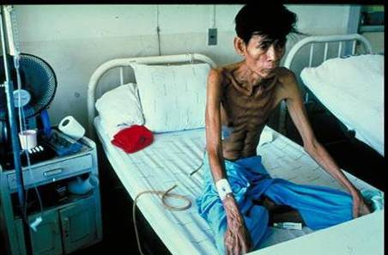
HIV-TB
1/3 of 33 million people living with HIV/AIDS co-infected with TB >10 million people
Without treatment 90% will die within months
TB is the leading cause of death among HIV positive people (up to 50% of all patients worldwide)

Slide 13
Emergence of “Worst-Case“ TB Scenarios

Slide 14
“Worst-Case“ TB Scenarios
Co-infection between TB and HIV
Multidrug-resistant TB
Extensively-drug resistant TB
Totally drug resistant TB?
Notes:
MDR TB is resistant to INH and Rifampin two most powerful TB drugs; XDRTB INH/Rif plus the fluroquinalones and at least one of the injectables (Kanamycin, Capreomycin, Amikacin)

Slide 15
Ebola vs Tuberculosis Which Disease is Greatest Risk for US

Slide 16
Ebola Epidemic in West Africa (Dec. 2013-March 2016)
As of 25 March 2016:
Country | Cases | Deaths (%)
Guinea | 3804 | 2536 (66.7)
Liberia | 10666 | 4806 (45.0)
Sierra Leone | 14124 | 3956 (28.0)
Nigeria | 20 | 8 (40)
Senegal | 1 | 0 (0)
Mali | 8 | 6 (75)
Spain | 1 | 0 (0)
USA | 4 | 1 (25)
Total | 28,603 | 11,301 (39.5)
http://www.who.int/csr/disease/ebola/situation-reports/en/

Slide 17
Funding for CDC for Domestic TB has been stagnant for the past 5 years (2010-2015) at $135 Million

Slide 18
Request for $243 Million (To meet the National TB Elimination Plan Goals) has been denied every year.

Slide 19
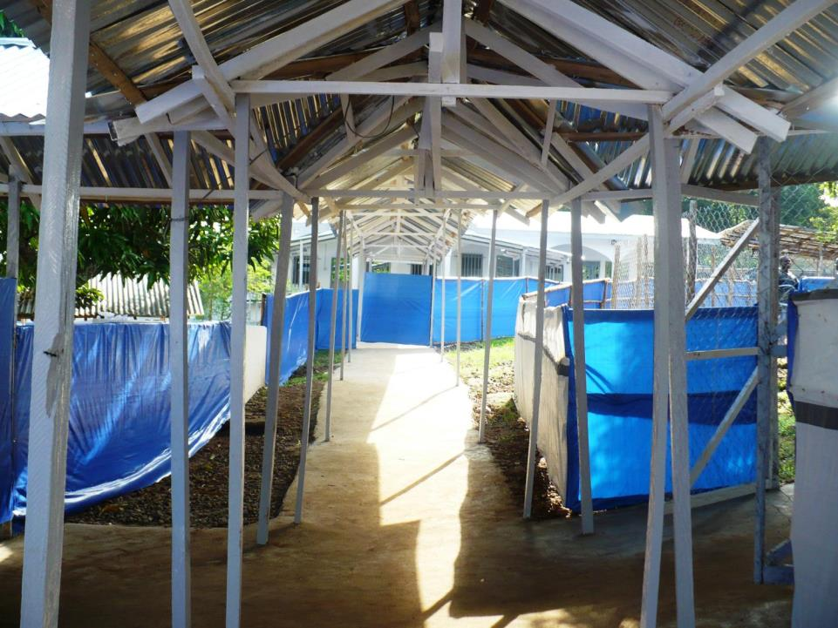
US Response to Other Diseases

Slide 20
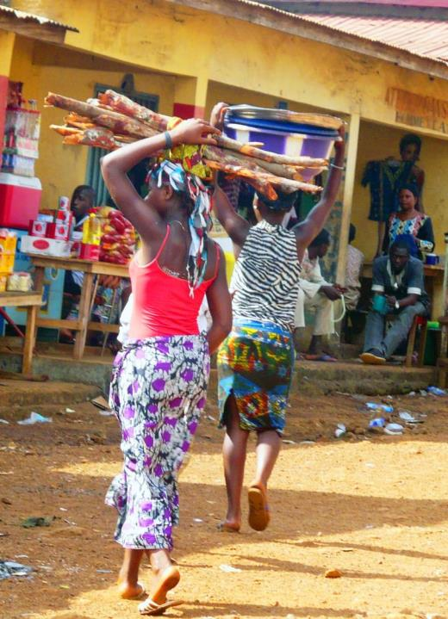
Ebola:
2014 $2 Billion
2015 $266 Million
2016 $8.7 Million
Ebola cases/deaths/US
4/1

Slide 21
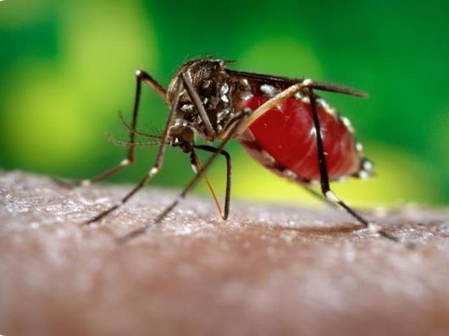
Zika 2016 $1.8 Billion
cases/deaths/US 273*/0

Slide 22
Burden of Tuberculosis in the United States

Slide 23
TB Morbidity United States, 2003-2015
Year | No. of Cases | Rate (per 100,000)
2003 | 14, 837 | 5.1
2004 | 14, 501 | 4.9
2005 | 14, 065 | 4.7
2006 | 13, 754 | 4.6
2007 | 13, 299 | 4.4
2008 | 12, 898 | 4.2
2009 | 11, 540 | 3.8
2010 | 11, 181 | 3.6
2011 | 10, 521 | 3.4
2012 | 9,951 | 3.2
2013 | 9,588 | 3.0
2014 | 9,406* | 2.95
2015 | 9,563 | 3.0
2.2% decline
1.7% increase
*Lowest since 1953

Slide 24
Reported TB Cases United States, 1982–2015*
No. of Cases
Year
*Updated as of March 25, 2016.

Slide 25
TB Morbidity United States, 2002-2013
TB disproportionately affects foreign-born persons (13.4 times higher than among U.S.-born persons), Asians, blacks, and people with HIV
Compared with whites, TB is 29 times higher for Asians, 8 times higher for blacks and 8 times higher for Hispanics.
More TB cases reported among Asians than any other racial/ethnic group in the US in 2014
Multidrug-resistant TB (MDR TB) cases accounted for 86 of all US TB cases in 2013 (1.2% of all cases)
18 cases of extensively drug resistant (XDR TB) (2008-2013), (2 cases in 2013; 2 in 2012; 5 cases in 2011) (>90% FB)
HIV status known for 85% of TB cases
6.8 % co-infected with HIV

Slide 26
What are the “Hidden Stats” on TB
Active TB cases 9,563
Contact investigation* identifies average of 17.9 contacts/active case; 1% new active case identified; 20% LTBI; estimated over 170,000 individuals that need to be evaluated, tested and offered preventive treatment if infected.
TB Infection (LTBI) Estimated >13,000,000 with ~ 10% risk of active TB in lifetime
*ARPE Report US, 2010 (CDC data 2/1/2015)

Slide 27
How Well Are We Doing with TB Contact Investigation?
2012 of the Close Contacts of Smear + Patients*
82% were evaluated
0.6% were found to have active TB
18.9% had LTBI
67% were started on LTBI treatment
44.6% completed treatment (24.7% of high risk contacts)
*MMWR/Jan 1, 2016/Vol.64/Nos.50 & 51

Slide 28
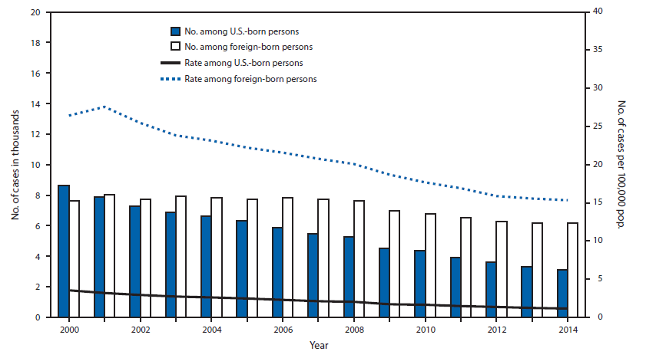
TB Cases in US-born vs Non-US-born persons United States, 2000-2014*
*Updated March 21, 2015 with provisional 2014 data
66.5% Foreign-born
Notes:
In 2014, the disparity in TB incidence between U.S.-born and foreign-born persons continued to increase. The total number of TB cases among foreign-born persons in the United States increased with a total of 6,181 TB cases reported (66.5% of all cases in persons with known national origin), representing a 1.5 percentage point increase from 65% in 2013. Despite the increased number of cases among the foreign born in 2014, the TB rate of 15.3 per 100,000 among foreign-born persons decreased 1.5% from 2013 because of an increase in the immigrant population. The 2014 rate among foreign-born persons represented a 42.0% decrease from the rate in 2000. In 2014, 55.3% of foreign-born persons with TB originated from five countries: Mexico (1,268 TB cases [20.6%]), the Philippines (745 [12.1%]), Vietnam (498 [8.1%]), India (472 [7.7%]), and China (420 [6.8%]).

Slide 32
Cost of TB Treatment
TB infection $700
TB Disease $17,000
MDR-TB $400,000
XDR-TB >$1,000,000

Slide 33
MCN Health Network
Eliminate health disparities due to patient mobility
Notes:
Responds to challenges in providing continuity of care through patient navigation; medical record transfer and bridge case management program

Slide 34
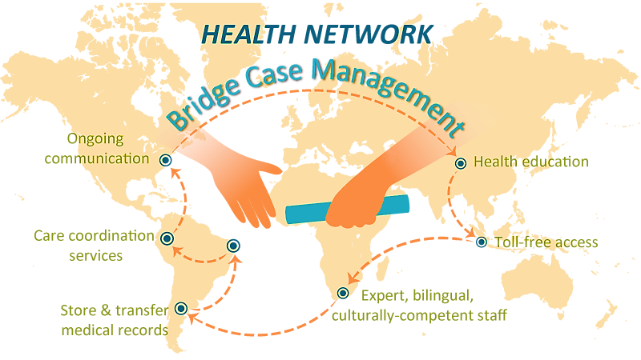

Slide 35
Forms Required for Enrollment

Slide 36
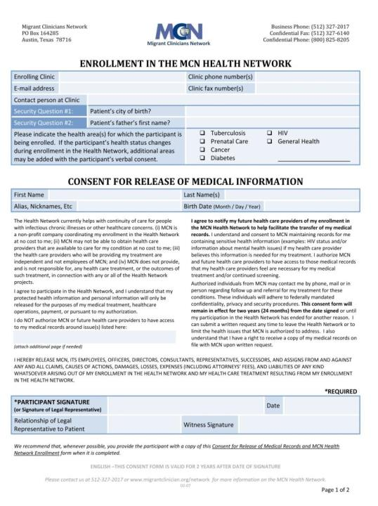
Gives MCN staff legal permission to transfer participants’ medical records and contact participants
Valid if sent within 5 business days of being signed by patient, remains valid for 24 months from the date signed
Must have the participant’s signature
Participants may renew their consent after it expires if they still need assistance

Slide 37
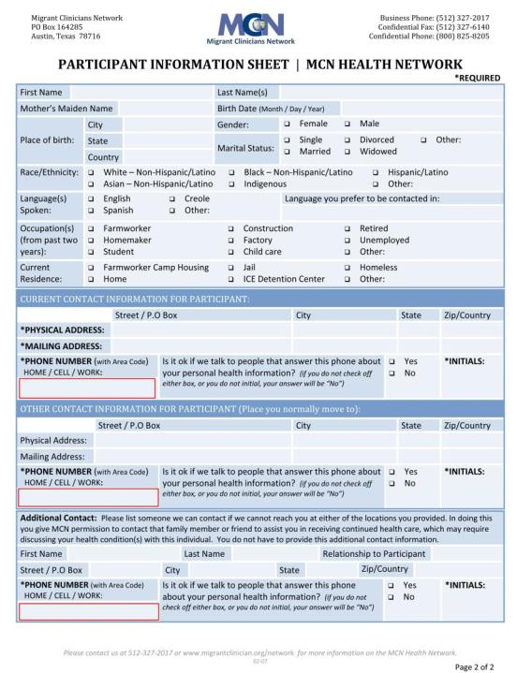
Notes:
I really like the post-it-notes on slide 21. If slide 22 could use the same device to highlight the need of "working" phone numbers/e-mail addresses, the importance of filling these out BEFORE a patient leaves, the usefulness of anchor contacts and secondary contact numbers in case the main number does not work-that would be awesome

Slide 38
Health Network Enrollment Criteria
1
Patient is:
Already mobile OR
Likely to move
2
Patient is in need of a clinic for follow-up of ANY health condition
3
Clinic Must:
Complete Enrollment Registration
Have patient sign Consent/Send
Send Medical Records

Slide 39
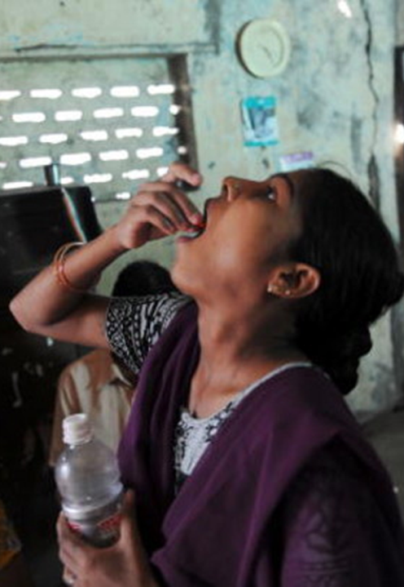
Health Network Maintaining a Patient in Care

Slide 40
Contacts patients on a scheduled basis (monthly for TB patients)
Contacts TB clinics monthly
Assists patients in locating clinics for services and resources
Reports back to the enrolling clinic and notifies them of outcomes

Slide 41
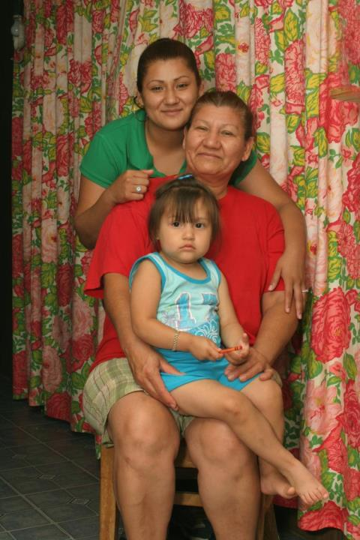
The Patient’s Role…

Slide 42
As many phone numbers as possible
###-###-####
###-###-####
###-###-####

Slide 43
Inform HN of any phone or address changes and contact HN staff after arriving in a new area

Slide 44
Stay on treatment as long as indicated

Slide 45
Providing Global Continuity of Care for Mobile Patients
2005-2015
Ed Zuroweste, MD
Chief Medical Officer
Migrant Clinicians Network

Slide 46
20 Years of innovation

Slide 47
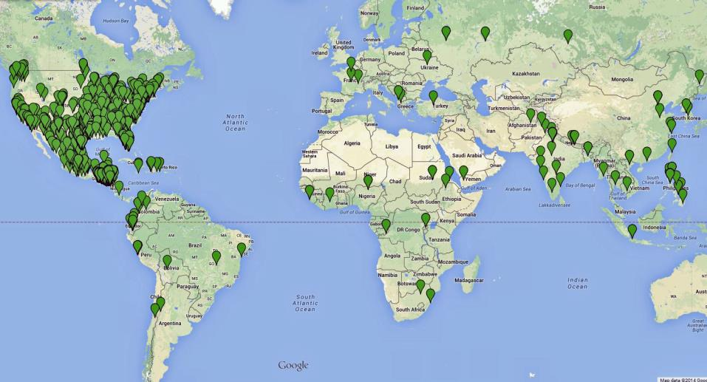
2,951 total clinics in U.S. and over 111 countries

Slide 48
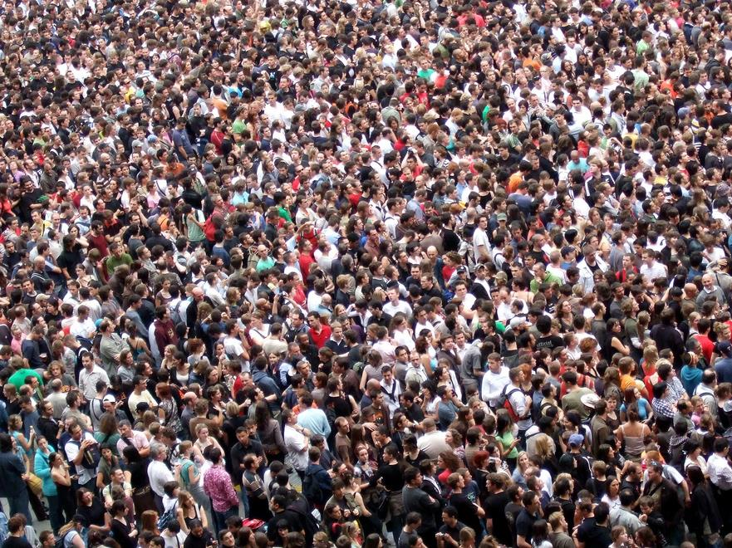
8,660 total HN enrollments

Slide 50
Nationality TBNet 2005-2014
Country (81Total Countries) | Total Class 3 patients (1,839 total patients) | Percent of total patients
Honduras | 502 | 27.3%
Mexico | 374 | 20.3%
Guatemala | 311 | 16.9%
El Salvador | 160 | 8.7%
India | 60 | 3.3%
China | 41 | 2.2%
Philippines | 34 | 1.8%
Nicaragua | 31 | 1.7%
Peru | 30 | 1.6%
Ecuador | 30 | 1.6%
United States | 28 | 1.5%
Haiti | 22 | 1.2%
Viet Nam | 16 | 0.9%
Honduras; Mexico; Guatemala; El Salvador | 1,347 | 73.2%

Slide 51
Nationality TBNet 2014
Country (25 Total Countries) | Total Class 3 patients (187 patients) | Percent of total patients
Guatemala | 44 | 23.5%
Mexico | 39 | 20.9%
Honduras | 31 | 16.6%
India | 13 | 7.0%
El Salvador | 10 | 5.3%
Philippines | 8 | 4.3%
China | 7 | 3.7%
United States | 5 | 2.7%
Nepal | 4 | 2.1%
Dominican Republic | 3 | 1.6%
Ecuador | 3 | 1.6%
Philippines | 3 | 1.6%
TOTAL | 187
Honduras; Mexico; Guatemala; India | 127 | 67.9%

Slide 53
Class 3 Active TB: TBNet Treatment Success (2005-2014)
(111 Total Countries)

Slide 54
1,737 Class 3 Active TB Cases Referred (40 not recommended by country)

Slide 55
1,670 Treatment Recommended
(26 MDR; 65 resistant to at least one drug)
29 deceased

Slide 56
1,641 Followed by TBNet for Active TB
168 lost to follow up
95 refused treatment

Slide 57
1,378 Complete Treatment 84.0%

Slide 58
Class 3 Active TB: TBNet Treatment Success (2014)
192 Class 3 Active TB Cases Referred
175 Treatment Recommended
4 deceased
171 Followed by TBNet for Active TB
15 lost to follow up
9 refused treatment
147 Complete Treatment = 86.0%*
*Preliminary Data 10 cases of the 198 need to be further reviewed and clarified

Slide 59
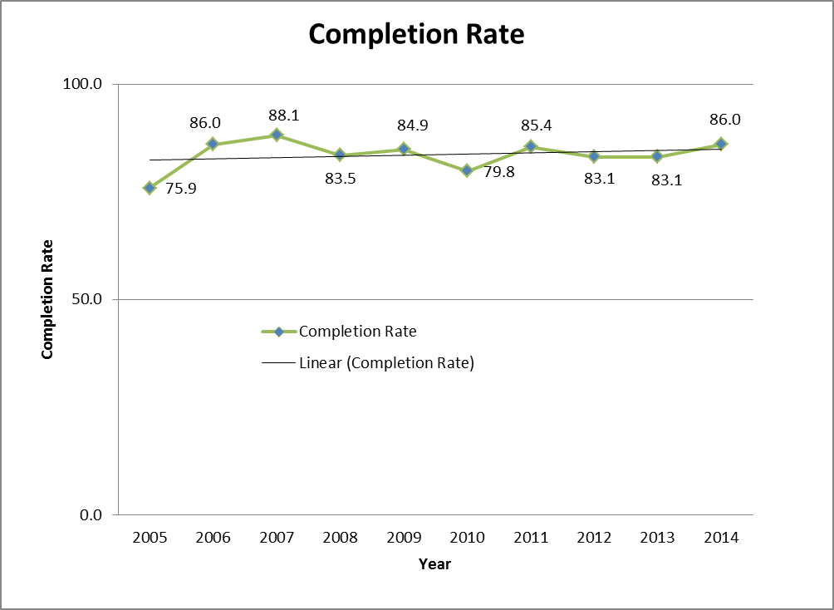
TBNet Treatment Success by Year*

Slide 60
But doesn’t it cost too much to follow these difficult patients?

Slide 61
Cost-effectiveness of bridge case management for tuberculosis infection treatment for mobile patients within the United States
November, 2015 Cynthia Tschampl PhD

Slide 62
Aims & Population
Aim 1: Modeled incremental health benefits of TBNet
TB cases averted
QALYs saved
Aim 2: Determined the cost-effectiveness of the TBNet, compared to the status quo (ICERs)
Population: 162 individuals referred for LTBI treatment with TBNet, 2005-2012; counterfactual cohort calculated using the literature
Notes:
Calculation done in Excel
3xs gross national income (GNI) per capita = cost-effective, $150,360; 1x GNI per capita = highly cost-effective, $50,120
Also calculated deaths averted, but the difference crossed the zero threshold suggesting the findings were not significant. In the majority of sensitivity analyses the BCM cohort averted a fraction of one death;

Slide 63
Findings

Slide 64
TBNet for LTBI patients highly cost-effective
$28,662 per QALY gained; $39,629/averted case (1x GNI per capita = highly cost-effective, i.e., $50,120)
Sensitivity analyses:
$33,009 (CI: $6,625-$90,056) per QALY saved; $45,678 (95% CI: $9,160-$124,514) per TB case averted
Notes:
Hypothesis was that BCM will be cost-effective
Societal perspective, discounted 3%
These are base case numbers, could provide a CI for incremental benefits from the probabilistic SA runs.

Slide 65
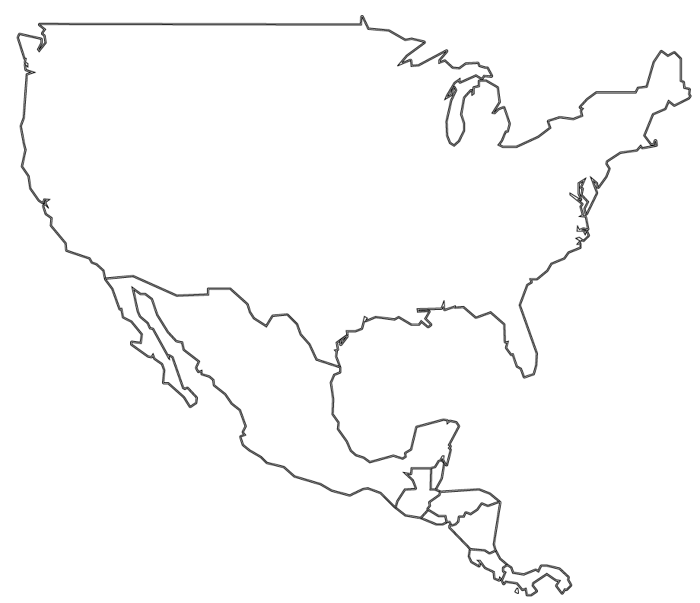
June 2010 patient contacts TBNet from the east coast having been released by “coyotes”
Medical records sent to clinic by TBNet and patient started on 4 drug regimen using DOT
Enrolled in TBNet prior to being deported to Central America
February, 2010
Screened in an ICE facility
Negative smear
RUL consolidation
TST 20 mm
Asymptomatic
Medication was not started
March, 2010 TBNet notified of positive culture results
Clinic found
Appointment made
Medical records transferred from both previous clinics
Patient resumed DOT
Wife in Central America updated on his progress
Treatment
completed
April, 2011
September 2010 patient calls TBNet to say he had moved to another east coast state
Medical records sent to his home country and family notified
May 2010, wife calls TBNet to say that her husband is being held by “coyotes” on the west coast of the United States.
TBNet case manager calls and is able to speak to the patient to explain the need for treatment
TBNet staff then initiates a human trafficking investigation via ICE

Slide 66
TBNet Successes

Slide 67
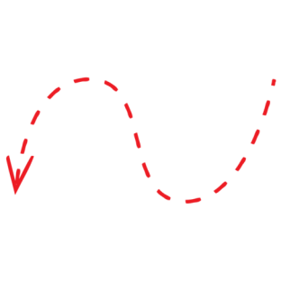
=
Geographically Stable Patients
Mobile Patients

Slide 68
Disease surveillance

Slide 69
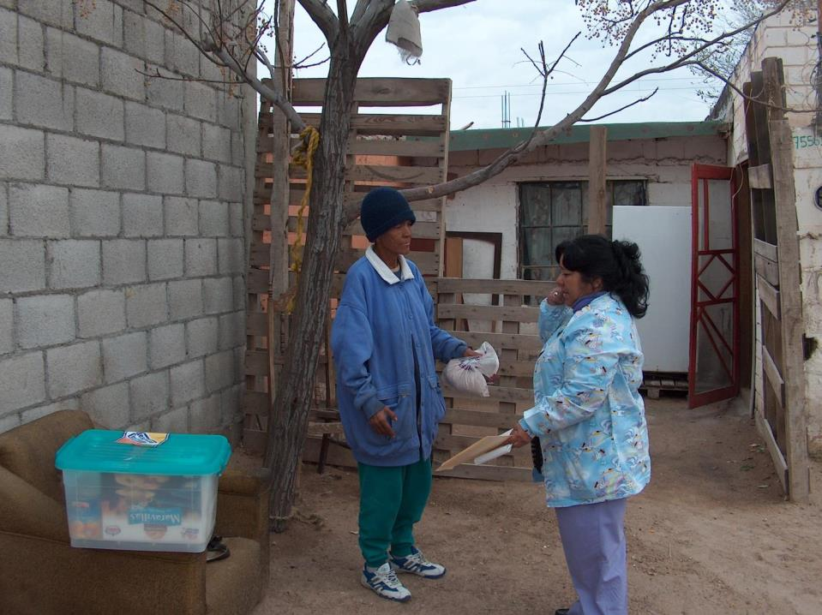
Consistency between international protocols

Slide 70
International recommendations on the identification of difficult to treat populations

Slide 71
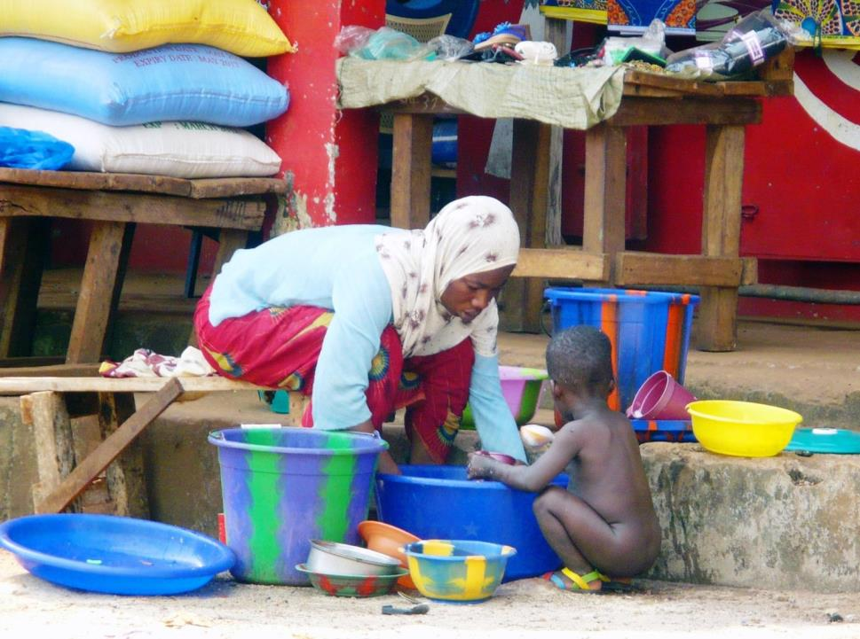
Model for management of other diseases in mobile populations
Photo: E. Zuroweste

Slide 72
Increasing Risks for All
Failure to develop measures to prevent and treat TB everywhere threatens our ability to control the disease anywhere
The elimination of TB in the U.S. will depend increasingly on the elimination of TB among the non-US-born
TB ANYWHERE IS TB EVERYWHERE!

Slide 73
Contact Us
Health Network telephone:
800-825-8205 (U.S.)
01-800-681-9508 (from Mexico)
Health Network fax: 512-327-6140
MCN website: http://www.migrantclinician.org/
If you have additional questions about the program, you may also contact
Ricardo Garay: 512-579-4508 or rgaray@migrantclinician.org
Notes:
-Pilot projects are a great way to get started, setting these up can easily be done by contacting Ricardo Garay
-Setting up trainings at your site can be a great way to line up protocols and incorporate seamless integration of Health Network

Slide 74
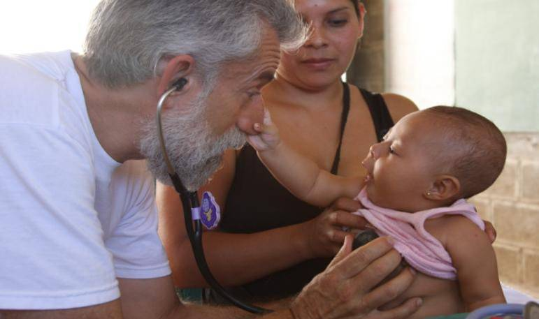
Contact
© Candace Kugel
Ed Zuroweste, MD 814-571-7395 ezuroweste@migrantclinician.org

